Slide 1
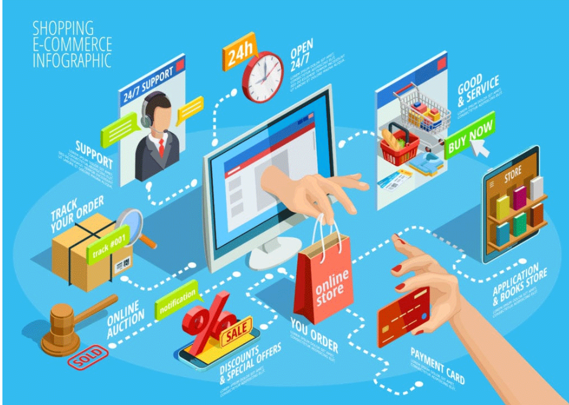
AmigoTech.in - E-Commerce Website for Techno Parts & Products
Group No 98
Presented By
Preetam Sarkar & Uday Wankar

Slide 2
Introduction
The Main purpose of developing the “AmigoTech.in - E-Commerce Website for Techno Parts & Products ” is to provide online solution for technical gadgets and appliances to consumers as one stop solution platform using internet. OSS will enable sellers to set up online store. Customers will be able to purchase products through virtual store. OSS would perform online business process automation such as one Shopping Cart management, Order Processing, Payment Processing, Customer Relationship Management as well as Shipment of ordered products.
The aim is to made all technical gadgets which are rare / unknown on a single platform to ease development activity for development and ease of mankind living.

Slide 3
Technology Used
We used Java Spring-Boot as backend ,MySQL for Database and React JS as Frontend in our Project.
Spring-Boot :–
The main goal of the Spring Boot framework is to reduce overall development time and increase efficiency. It reduces lots of development time and increases productivity. It avoids writing lots of boilerplate Code, Annotations and XML Configuration. It is very easy to integrate Spring Boot Application with its Spring Ecosystem like Spring JDBC, Spring ORM, Spring Data, Spring Security etc.
MySQL:–
MySQL is a free-to-use, open-source database that facilitates effective management of databases by connecting them to the software. It is a stable, reliable and powerful solution with advanced features like the following:1. Data Security
2.On-DemandScalability 3.High Performance 4.Round-The-Clock Uptime 5. Comprehensive Transactional Support 6. Complete Workflow Control 7.Reduced Total Cost Of Ownership 8.The Flexibility Of Open Source

Slide 4
Technology Used
React :–
React has become the first choice for frontend because it gives developers the ability to work with a virtual browser (more friendly than the real browser). Also, a JavaScript developer can become a productive developer in a few hours because there is a small API to learn, a few functions, and how to use them…
React allows developers to create large web applications that can change data, without reloading the page. The main purpose of React is to be fast, scalable, and simple.
Node JS:–
Node.js: uses non-blocking, event-driven I/O to remain lightweight and efficient in the face of data-intensive real-time applications that run across distributed devices.

Slide 5


Use Cases
Guest
Customer
Admin/Staff
Guest is new or any user who dont have registration and is unknown .To enhance the use of this application the guest is allowed to browse through the site without registration.
In this module the guest successfully completes the registration and has his account in this site, the customer is allowed to buy product online as per his choice.The account details are mainted with the purchase history.
Admin may be owner or manager who manages this app.The admin will be able to update ,add and delete products. He can manage stock and delivery of the products,also will manage the staff.

Slide 6
Product Functions
01
shopping Portal- Web site (Web Application) (Online Store)
Uniform Access- Consumers, admin(BOD, Owner) ,staff(suppliers, sellers), would be able use same web site.
02
Product Gallery & Product Details (Product Catalog)- For the ease and convenience for product buying ,selling , sorting and filter
03
Order Processing, Bill generation- For to achieve the main goal of business i.e buying and selling ,online order processing and bill generation for future use.
04

Slide 7
Product Functions
05
Payment processing –online payment mode eases the money exchange and digitalization.
06
Shipping parcels at customer end as well Tracking Delivery-On the successful payment the admin is supposed to deliver the product with the estimated time.
Customer Relationship management- The mail/feedback from the customer is always welcomed .
07
Seller Dashboard-To have records and business flourishment all order details to be listed as needed.
08
09
Additonal Features–OTP authentication , invoice generation and mail communication
.

Slide 8
Guest Module
Any new User who has not logged in is treated as Guest ,
The guest can browse through site and see all the products available in the website..
The guest has only privilege to surf , search all the products.
If the guest want to purchase any product he is forced to signup in case don’t have existing account or can signin is already an user.
.

Slide 9
Customer Module
After successful registration, the guest is treated as Customer
The customer can browse through the site for product to buy.
He can buy the product online and can pay online as well and has any desired location as shipping address.
Customer can check his all order history.
Customer can update his profile details if any needed.
In case of password is lost he can reset the password with OTP authentication.
The products can be sorted based on price low or high or vice versa or can filter the product as needed.

Slide 10
Admin Module
The Admin has the whole control over the site
Can add update delete the product from catalogue.
Can get all order details and history.
Track or update the delivery status of all delivery.
Add staff or remove staff in the from the administration.
Search, sort the products based on requirement.

Slide 11
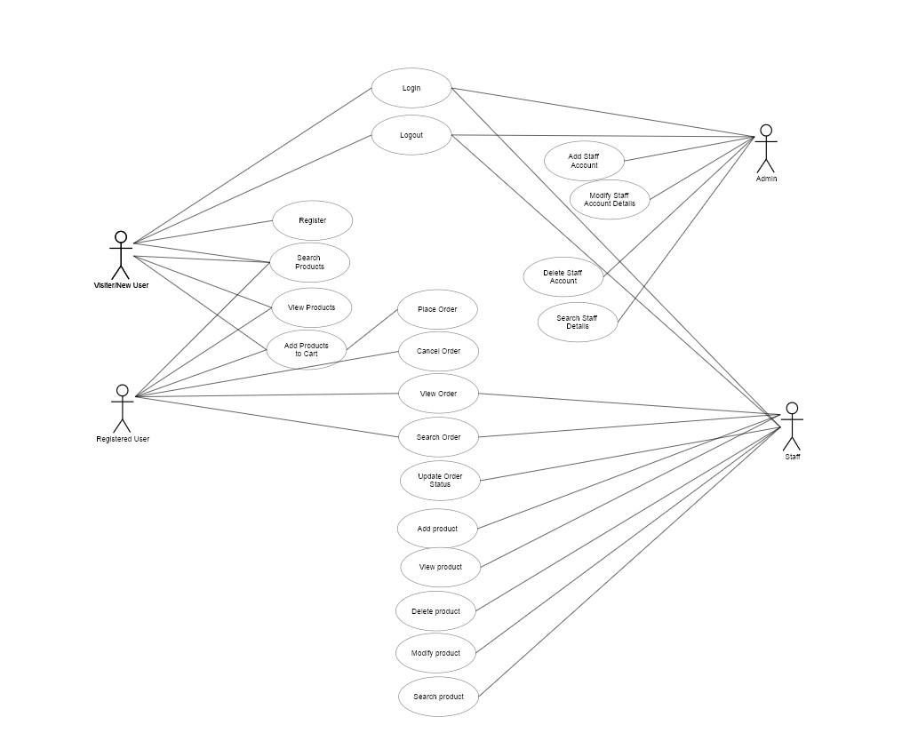
Use Case diagram

Slide 12
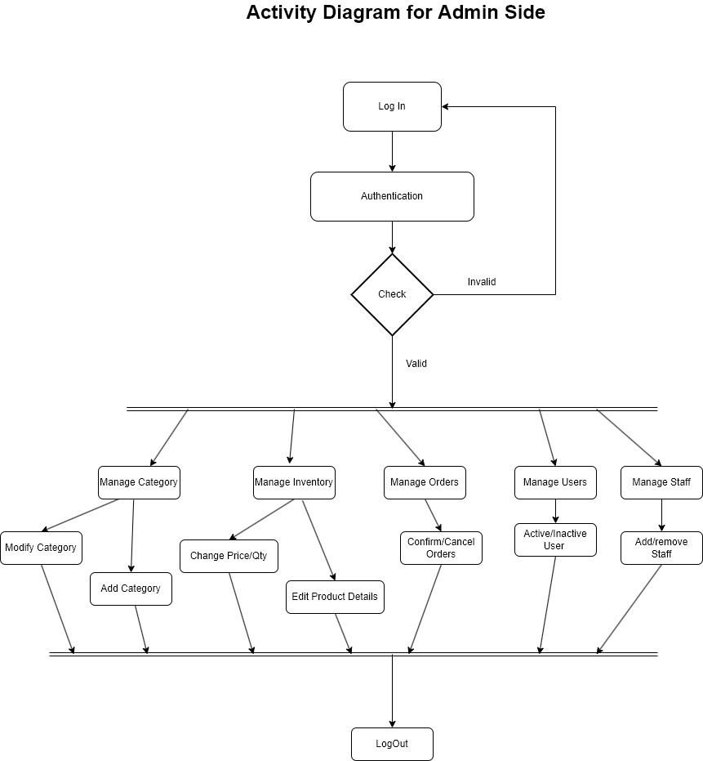
Activity Diagram : Admin

Slide 13
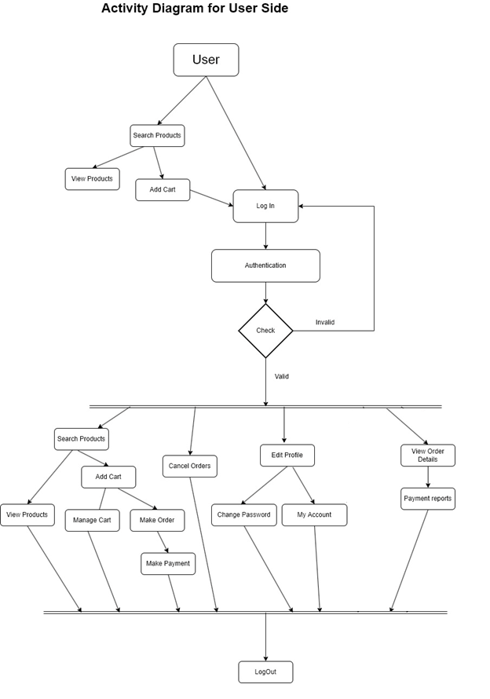
Activity Diagram : User

Slide 14
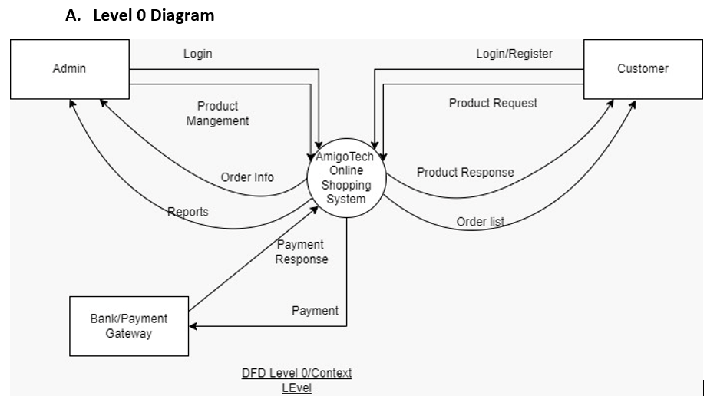
DFD Diagram:

Slide 15
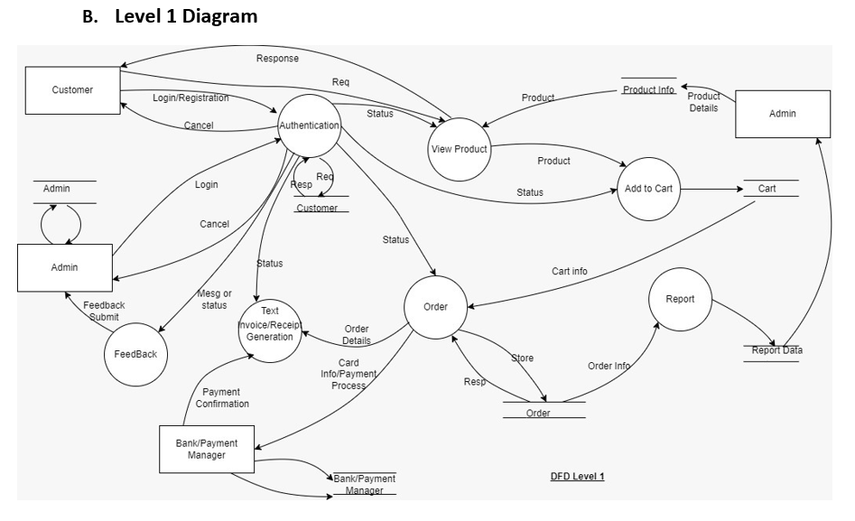
DFD Diagram:

Slide 16
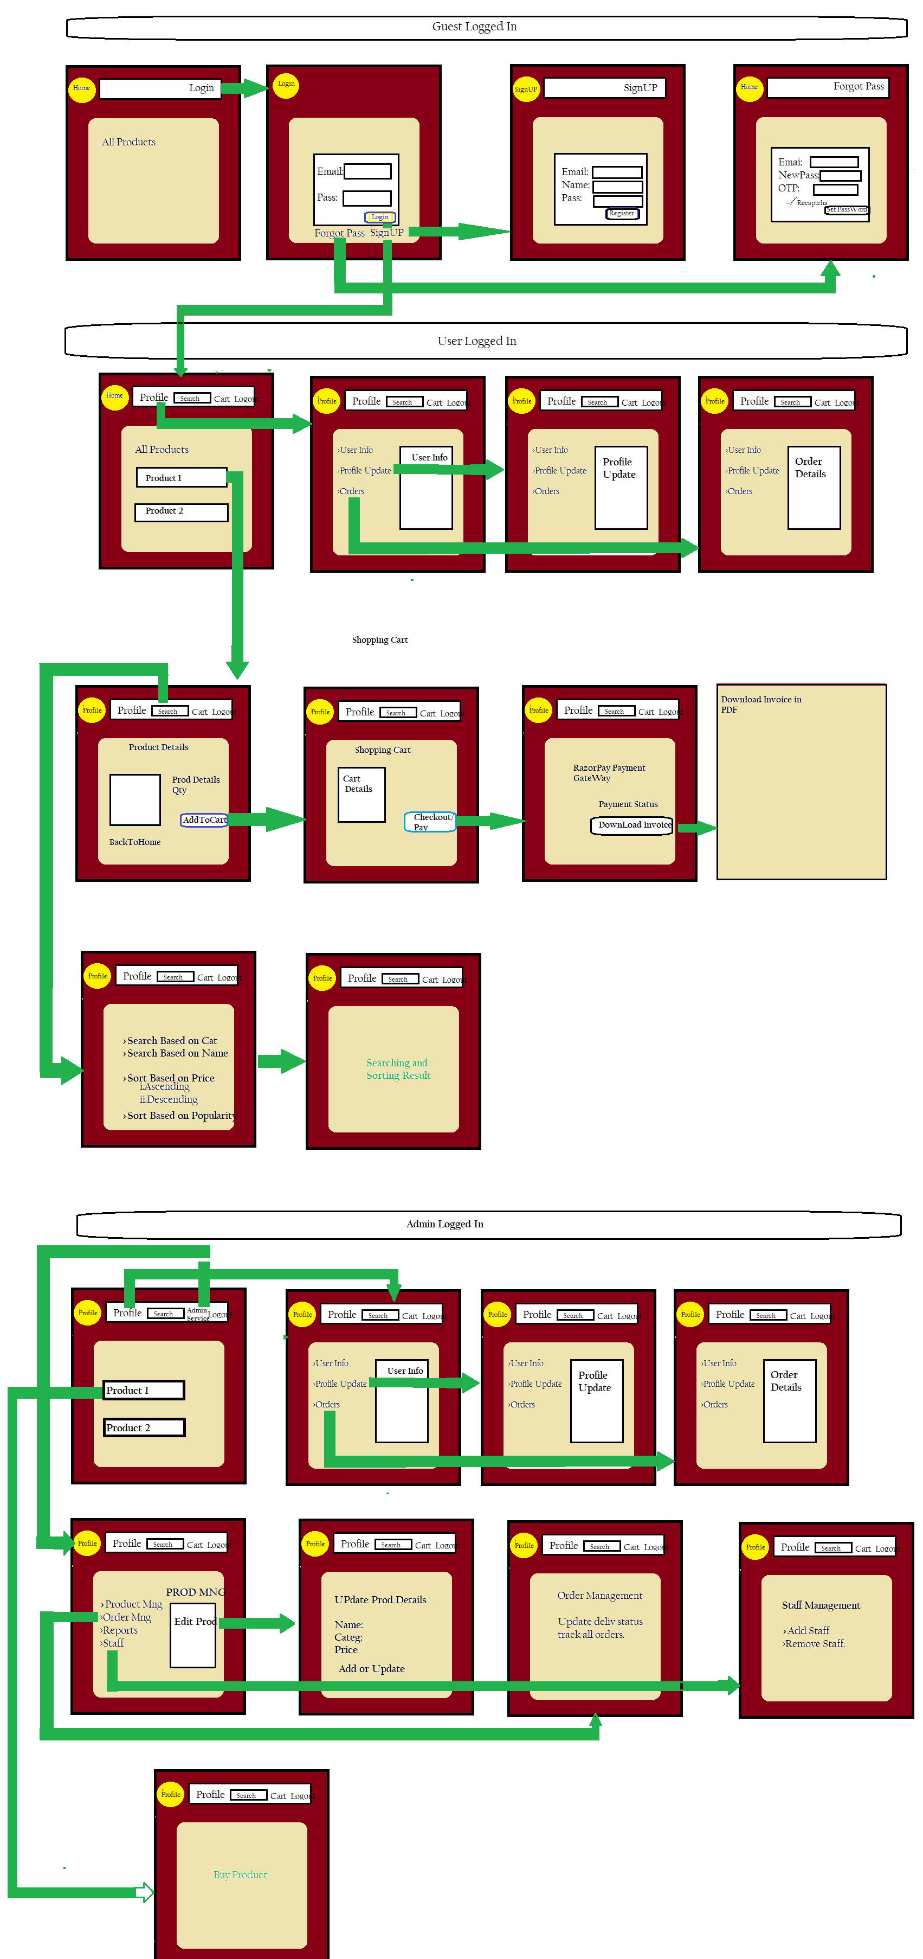



UI: Diagram

Slide 17
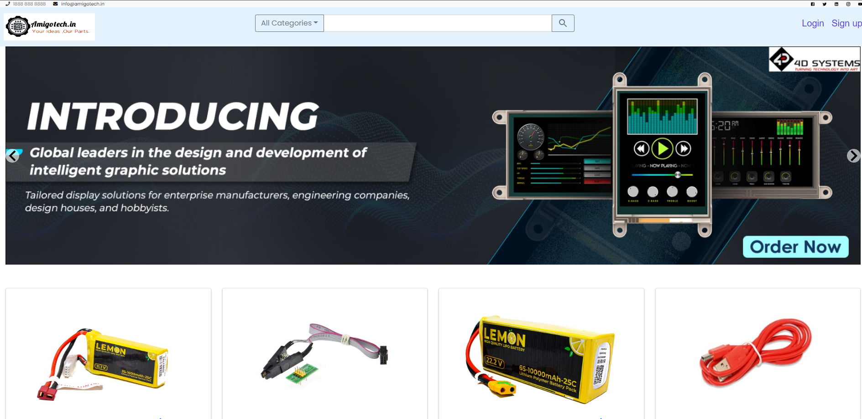
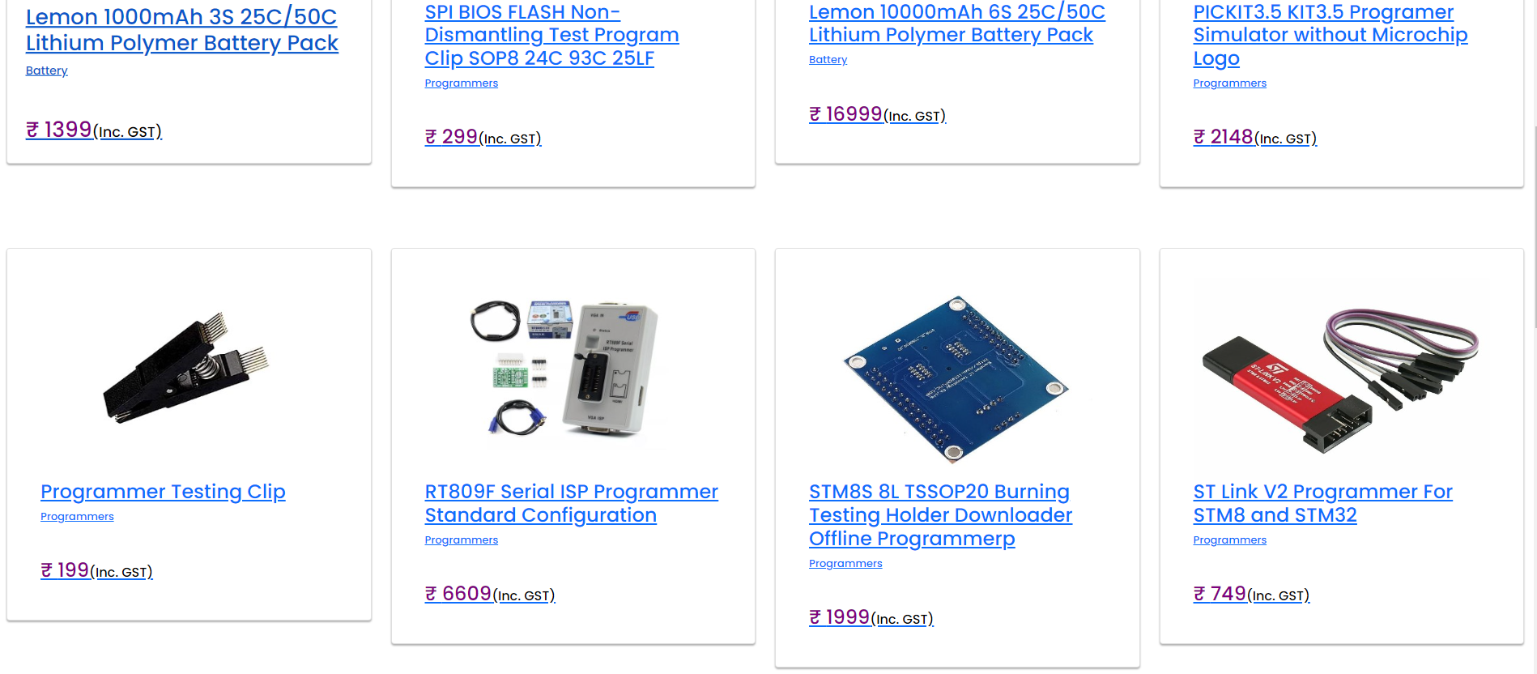
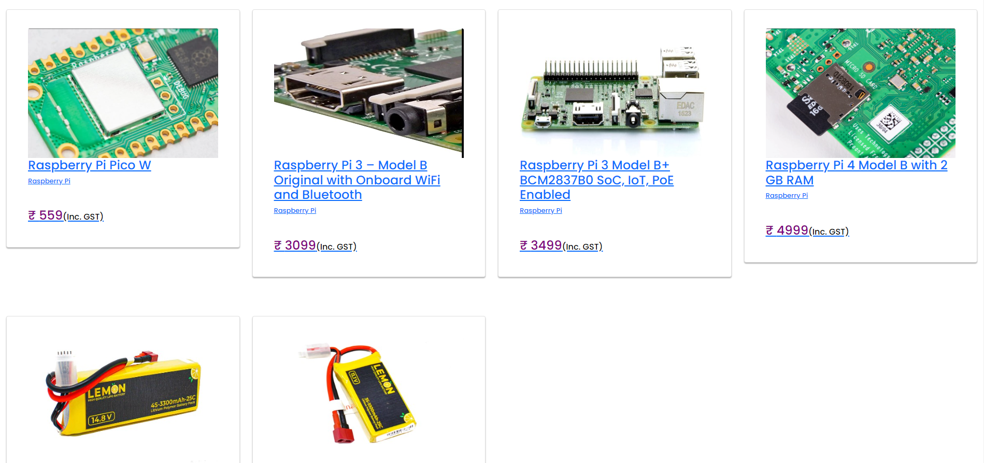
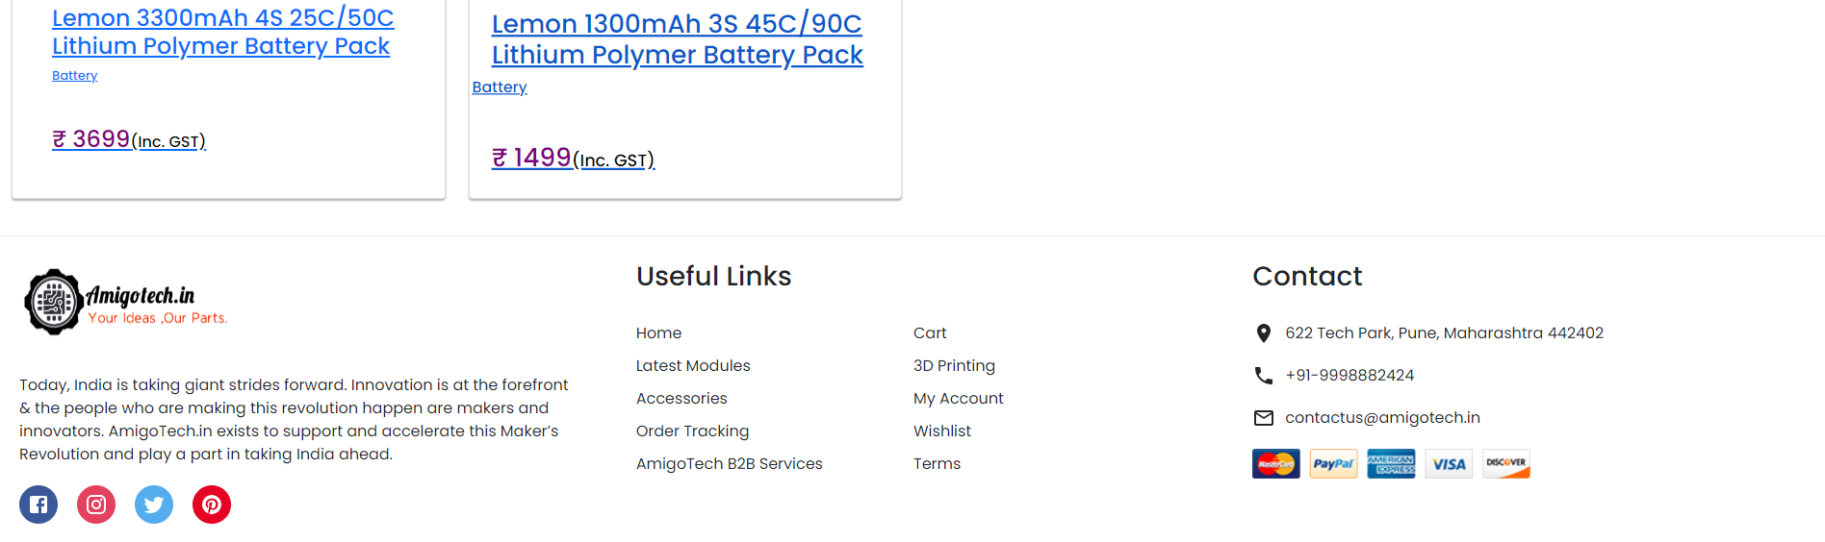
Home Page

Slide 18
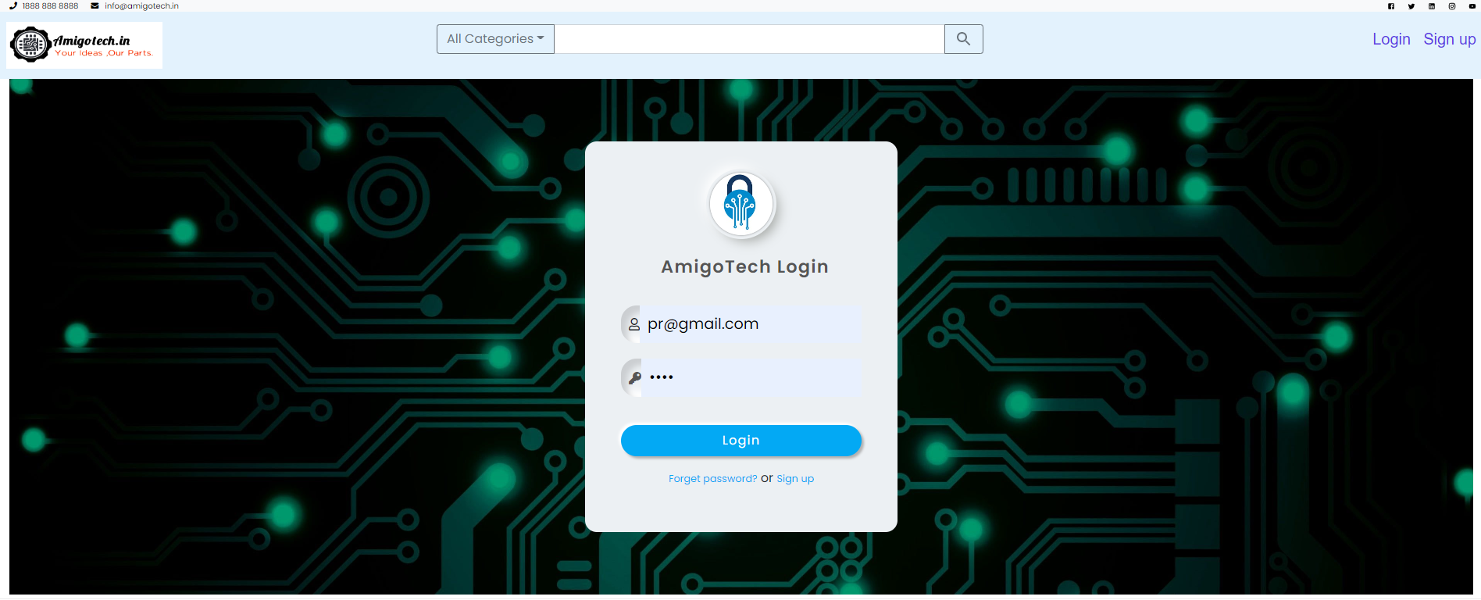
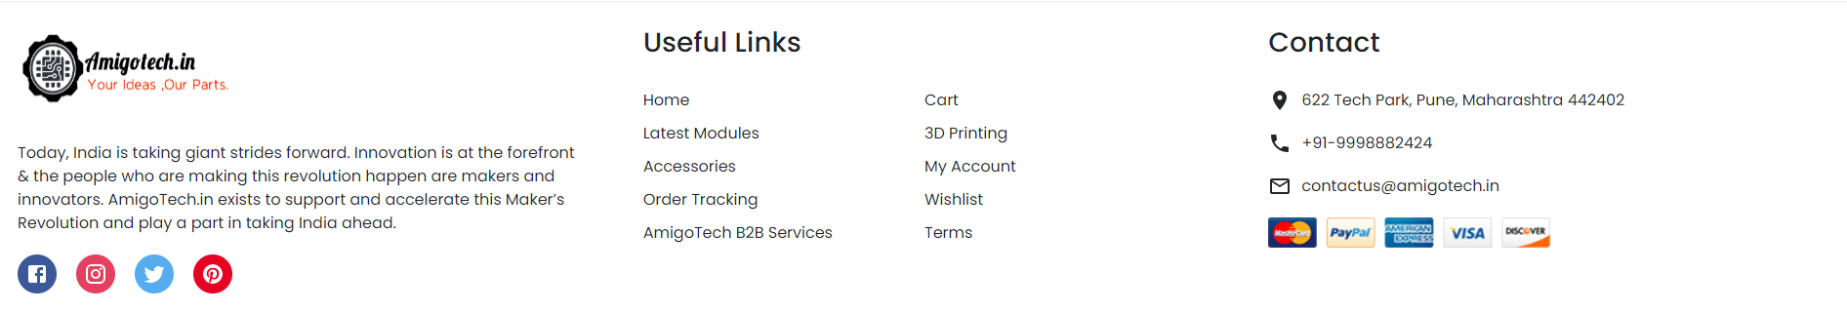
Activity Diagram : Login

Slide 19
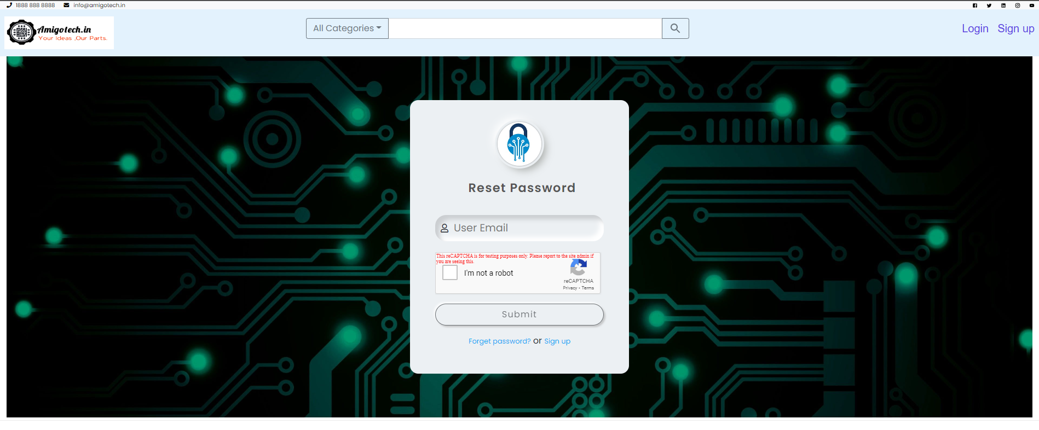
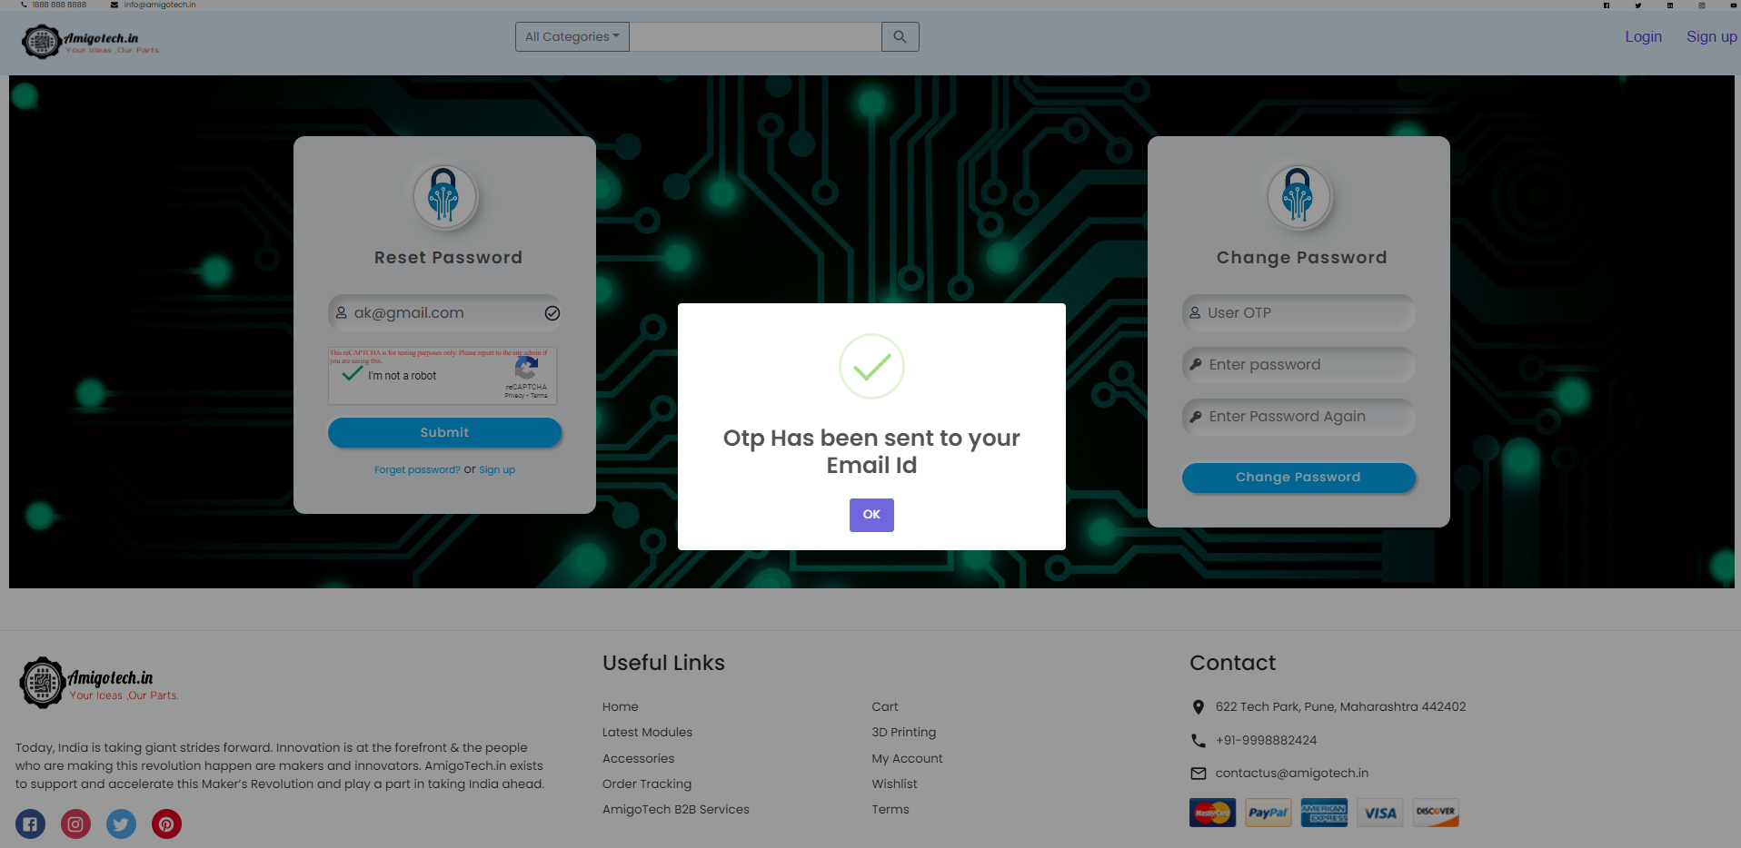
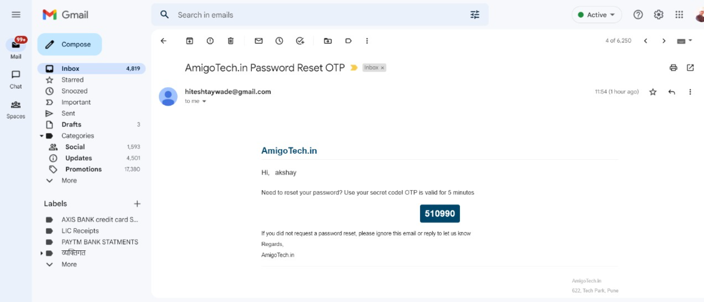
Forgot Pass/Reset Password

Slide 20
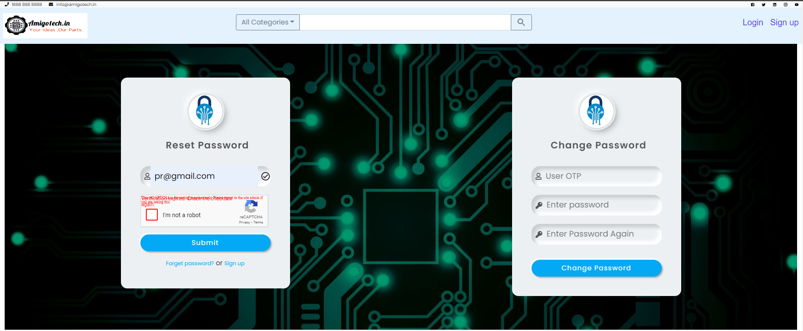
Forgot Pass/Reset Password

Slide 21
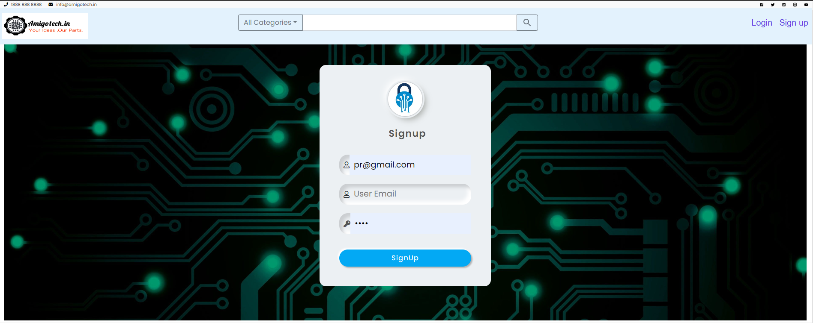
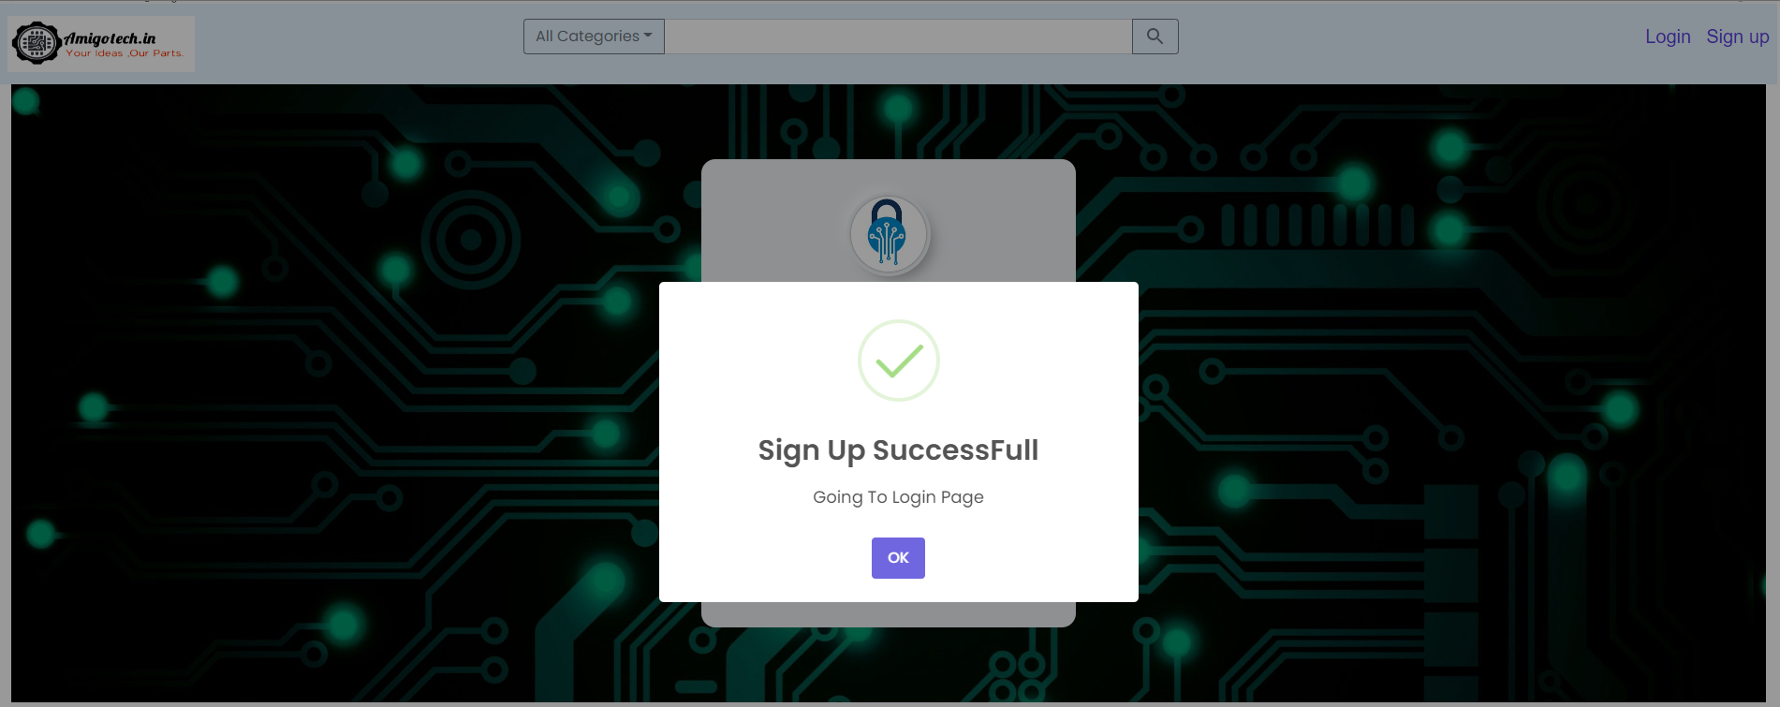
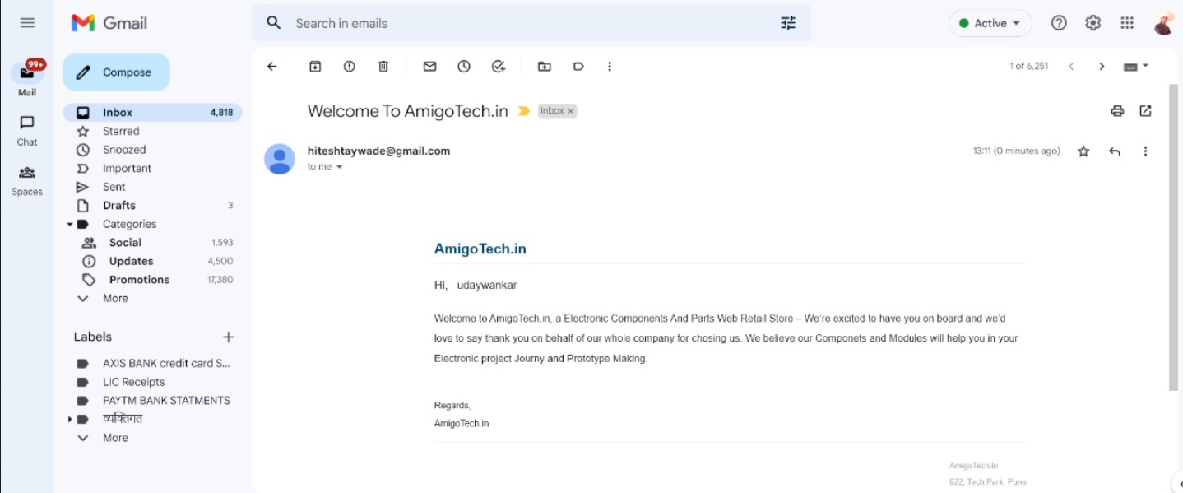
SignUp Page

Slide 22
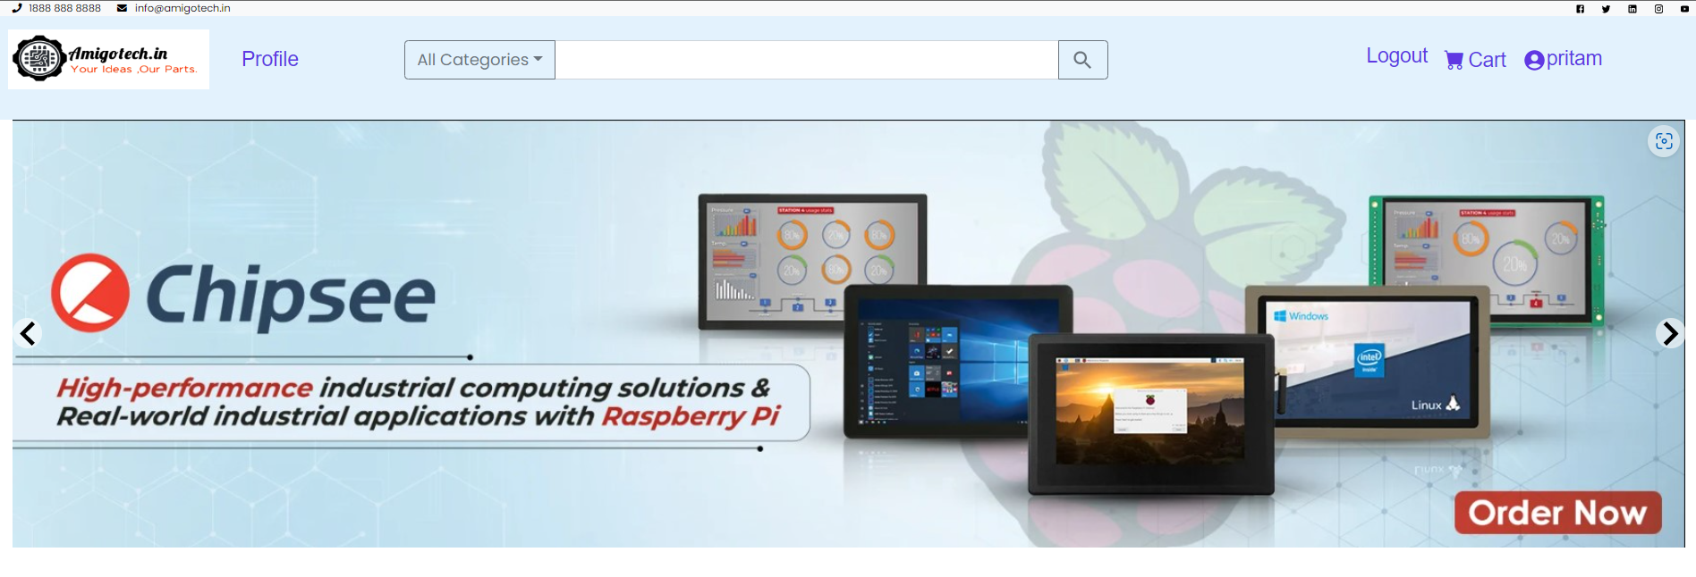
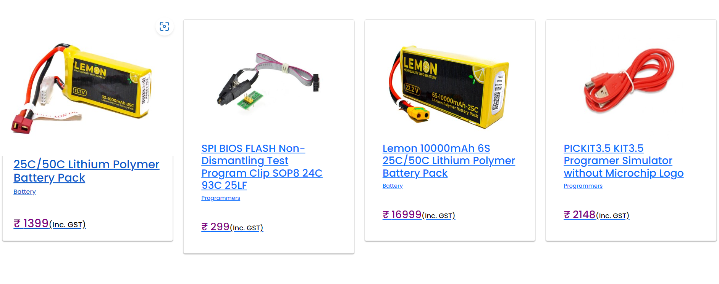
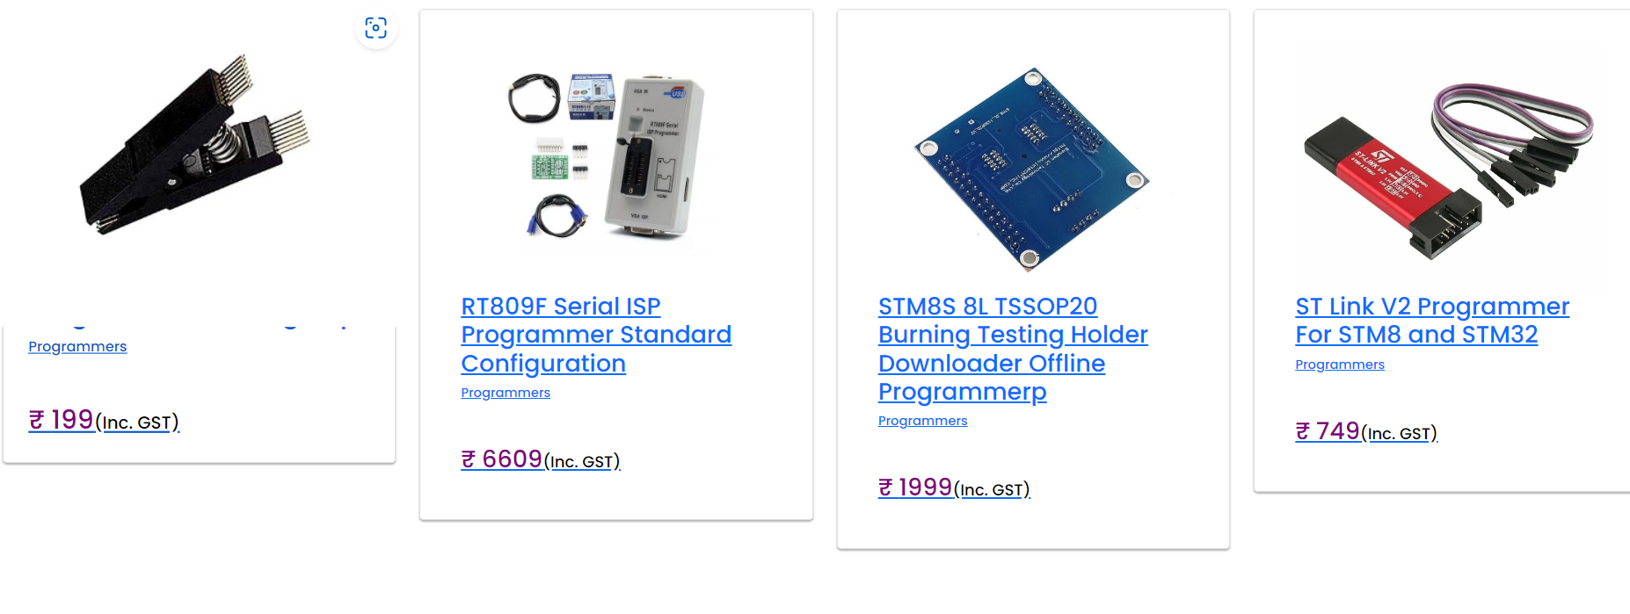
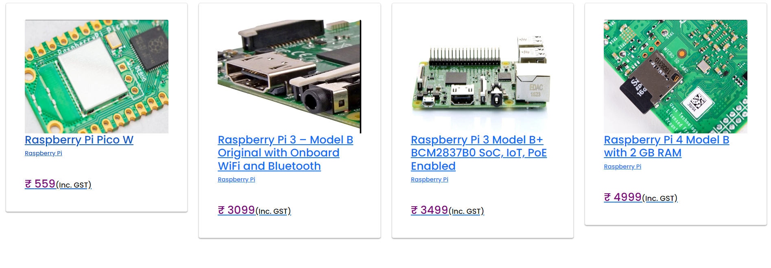
Customer Home Page After Login

Slide 23
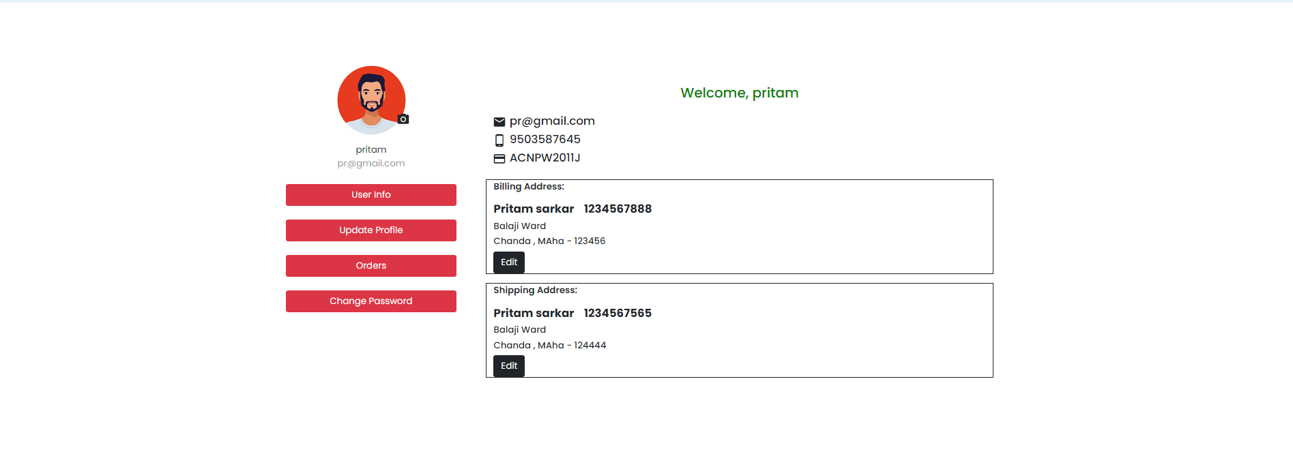
Customer Profile Info

Slide 24
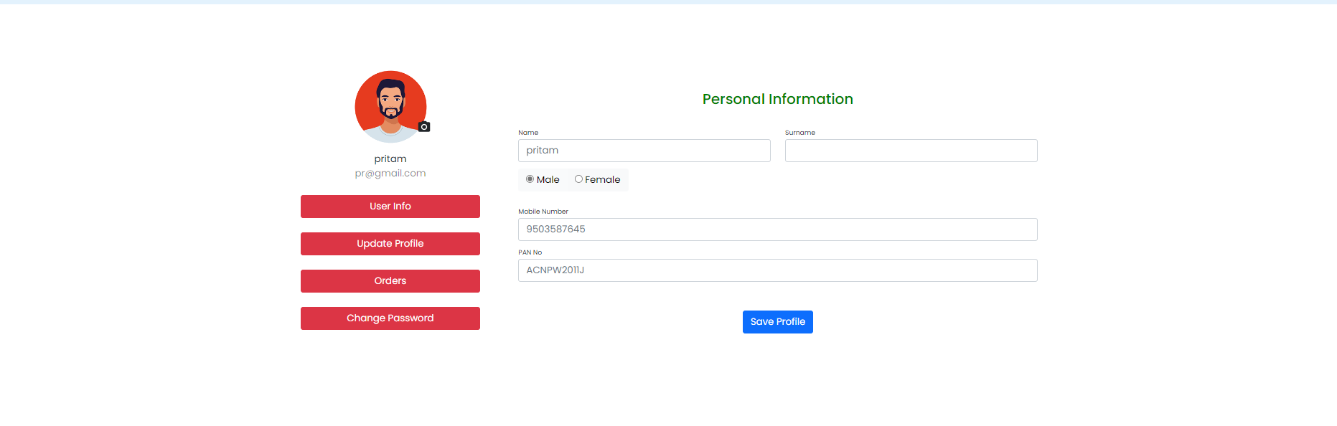
Customer Update Profile

Slide 25
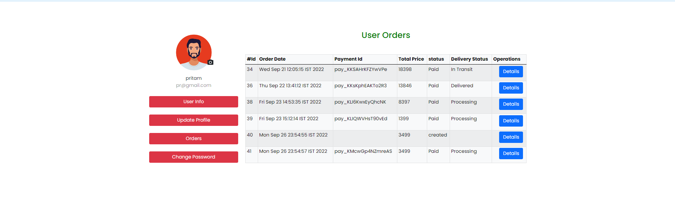
Customer Orders

Slide 26
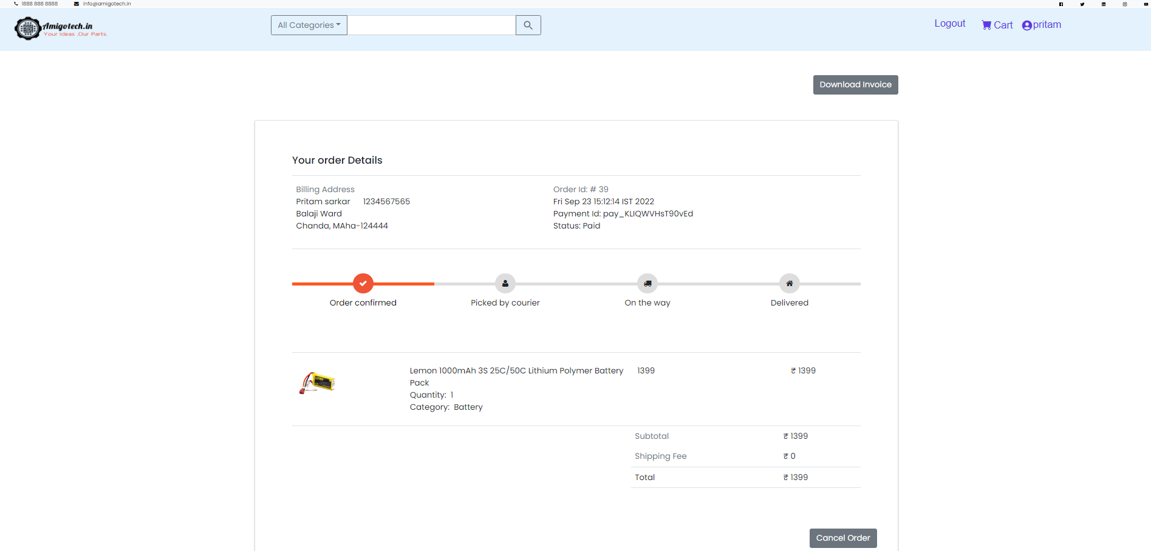
User Order Details

Slide 27
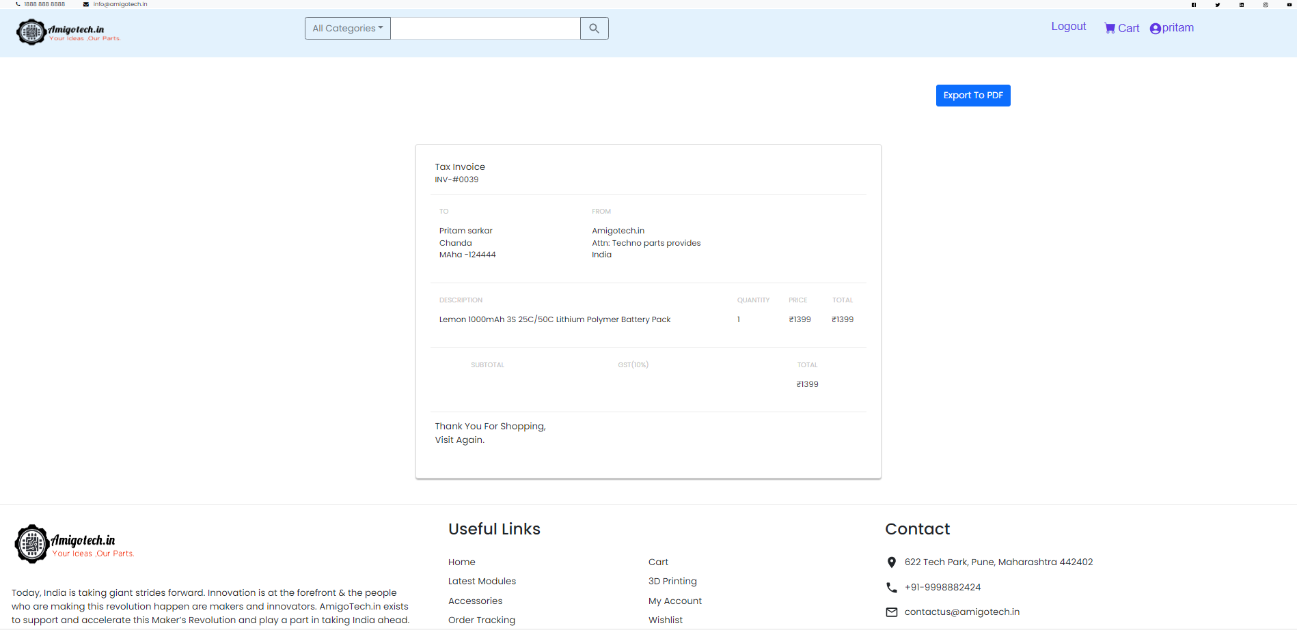
Customer Order Dowload Invoice

Slide 28
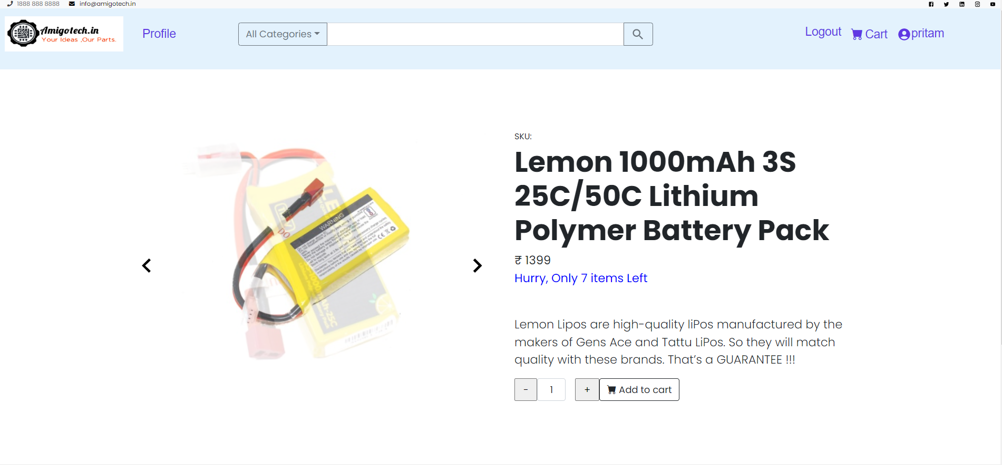
Single Product Details

Slide 29
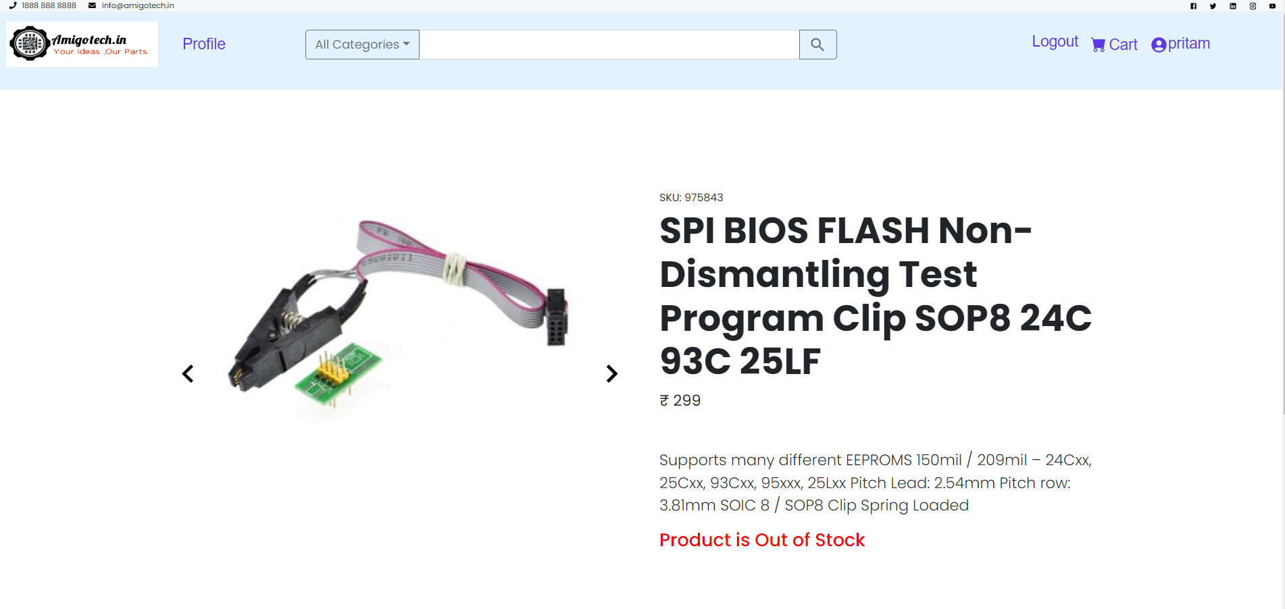
Single Product Detail –Out of stock

Slide 30
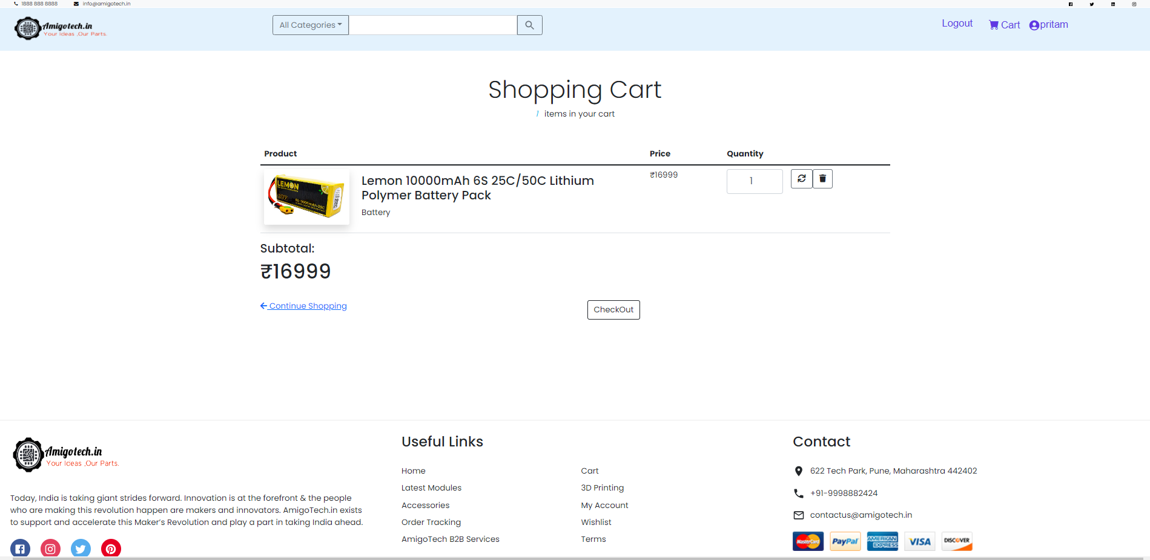
Shopping Cart

Slide 31
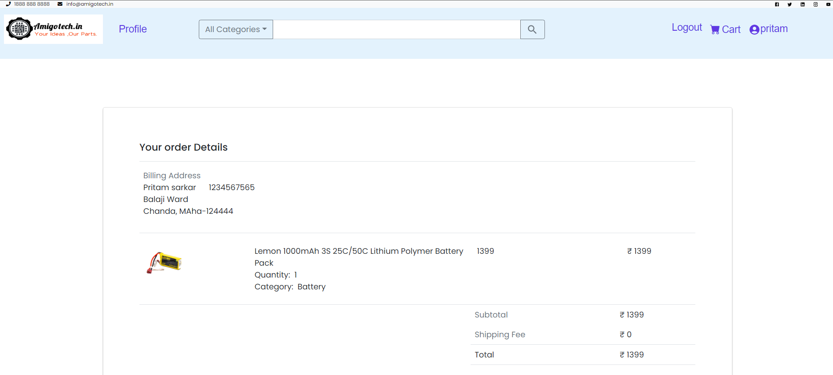
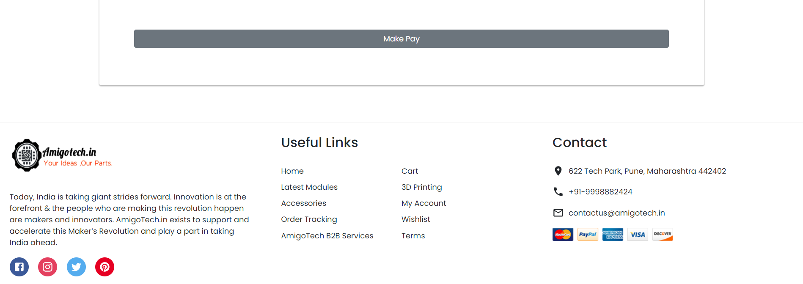
Products in cart

Slide 32
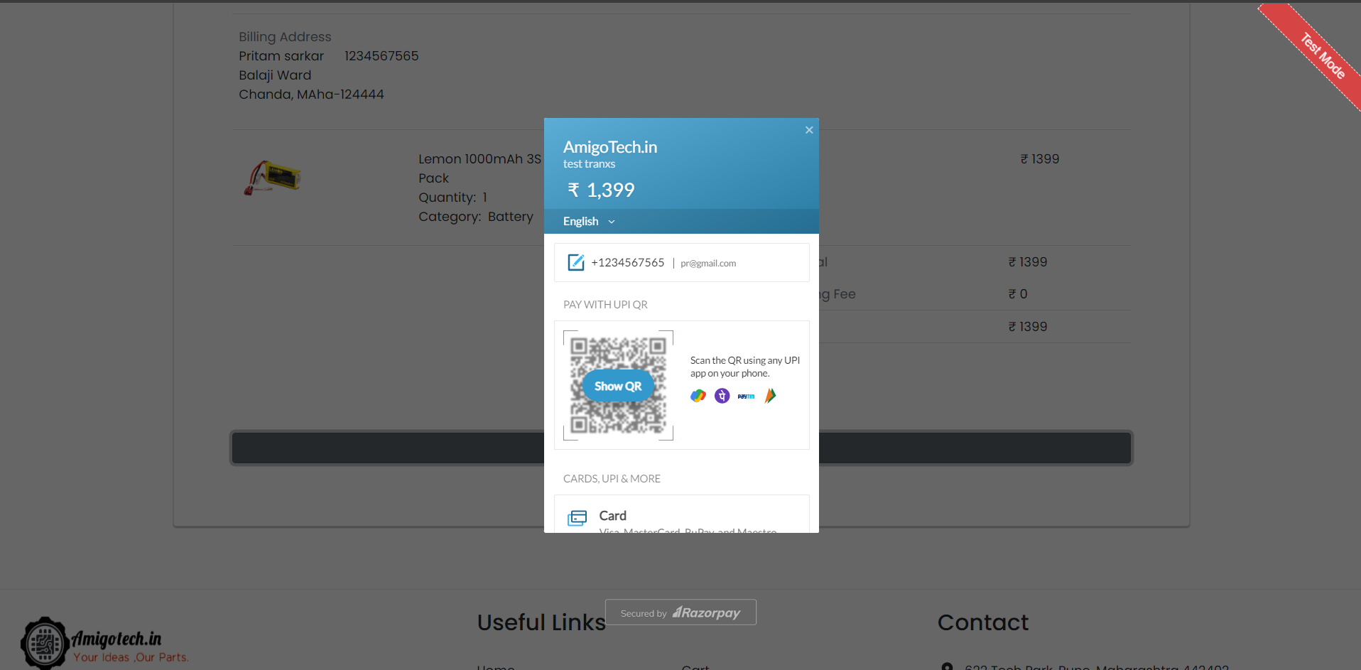
RazorPay Payment Processing

Slide 33
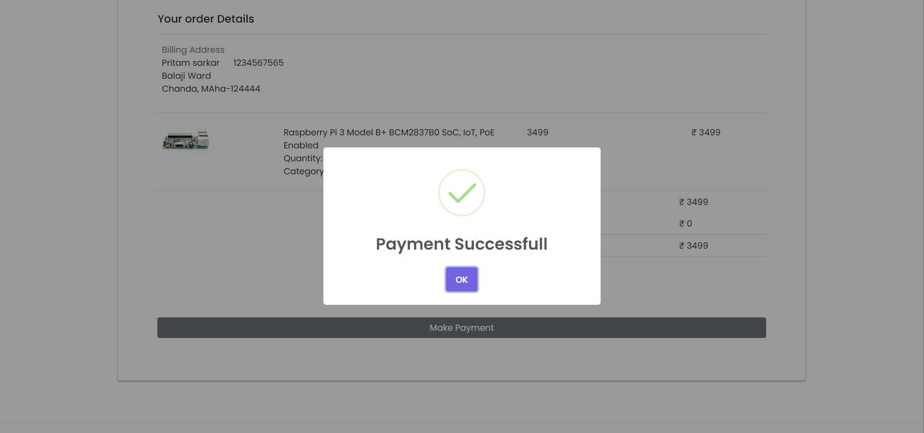
Payment Successful

Slide 34
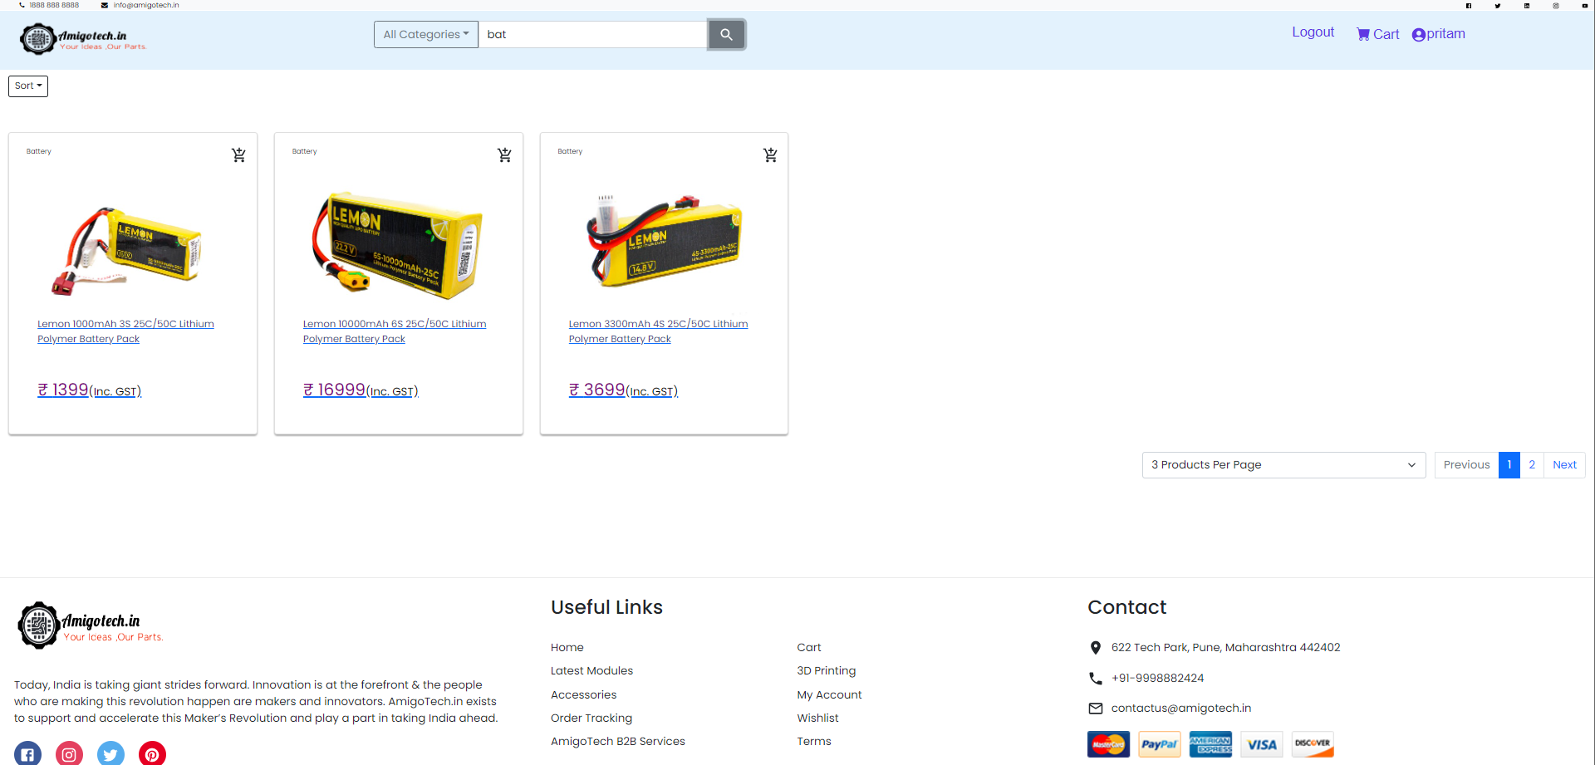
Search Feature

Slide 35
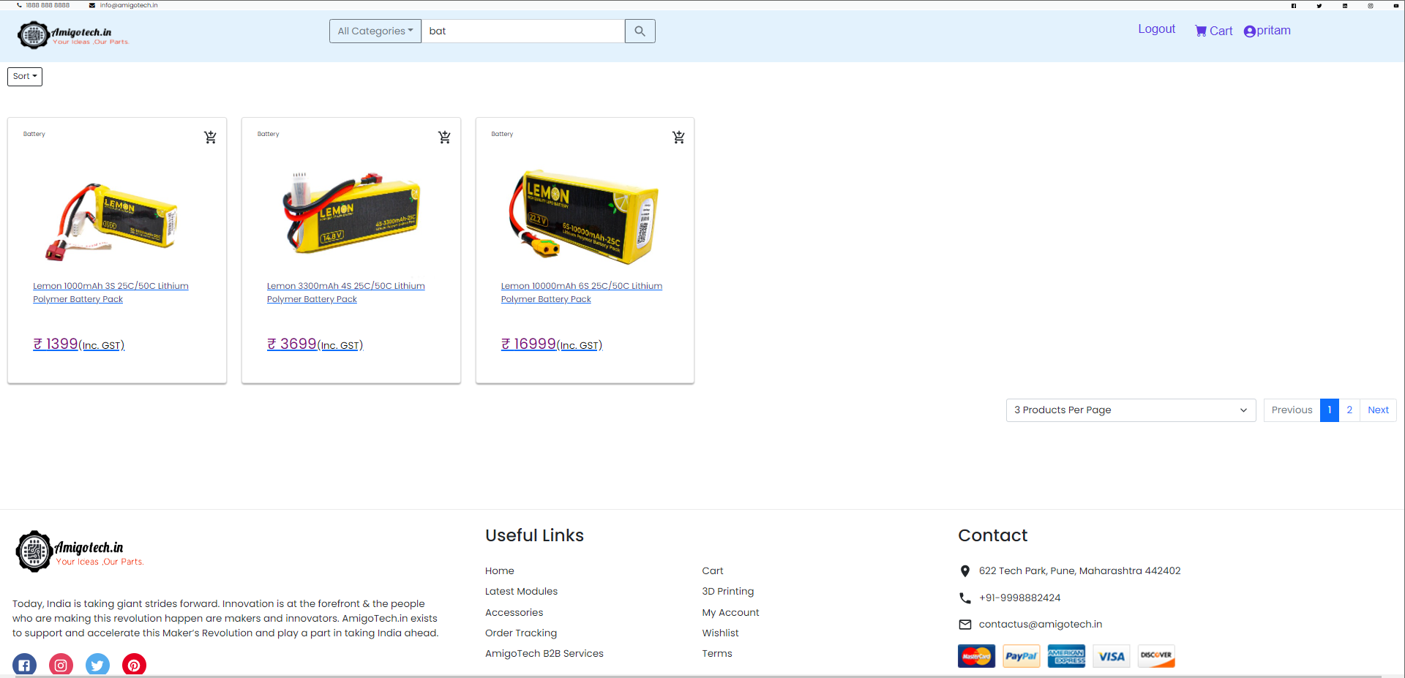
Sort: by price low to high

Slide 36
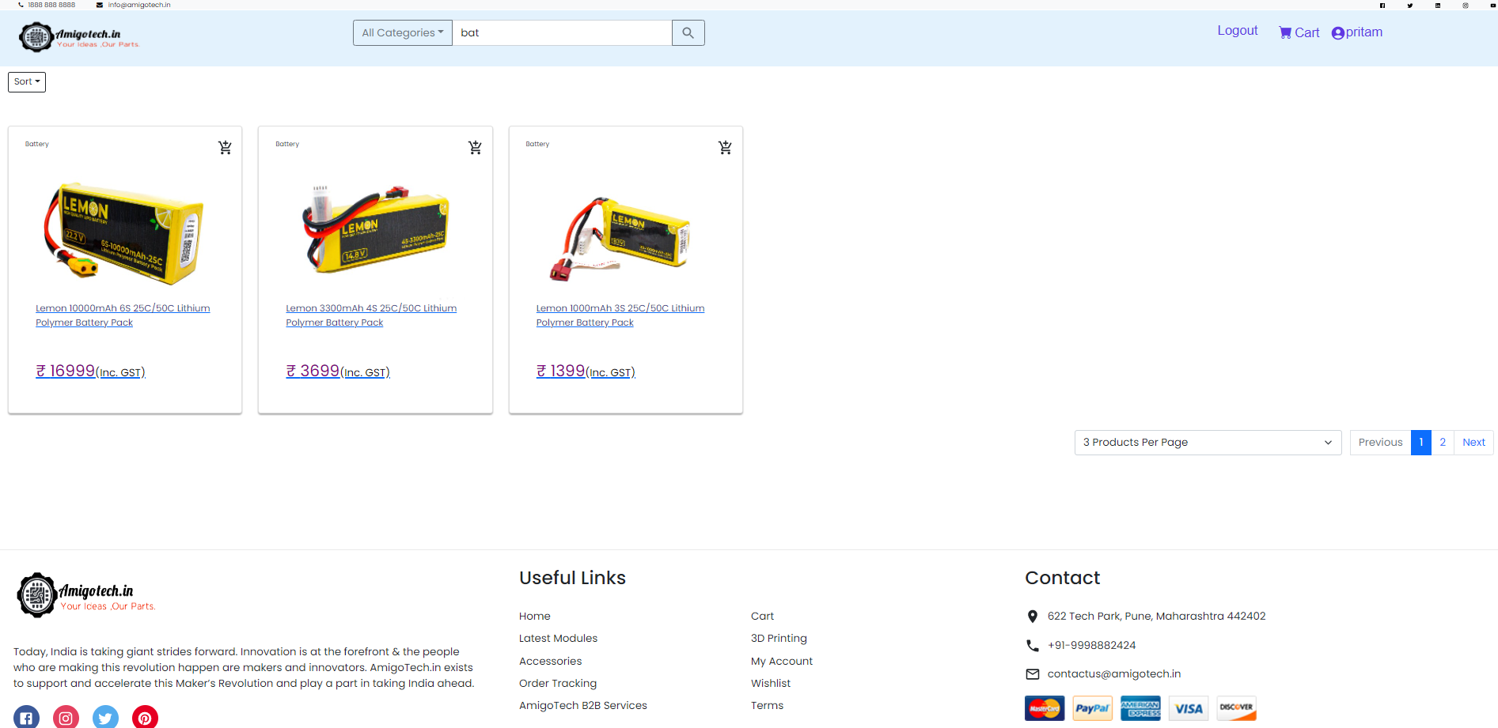
Sort by price high to low

Slide 37
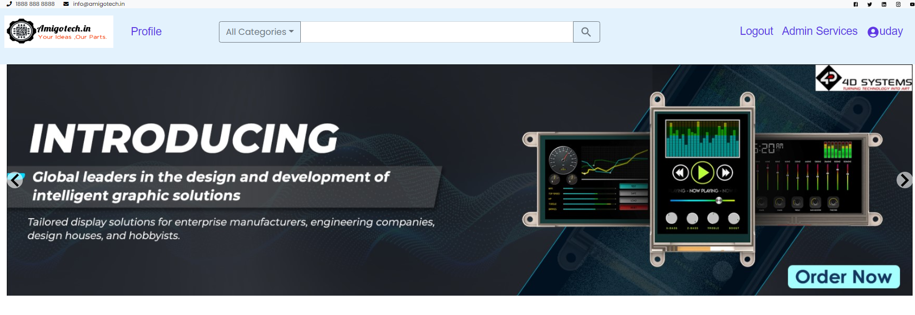
Admin Home page

Slide 38
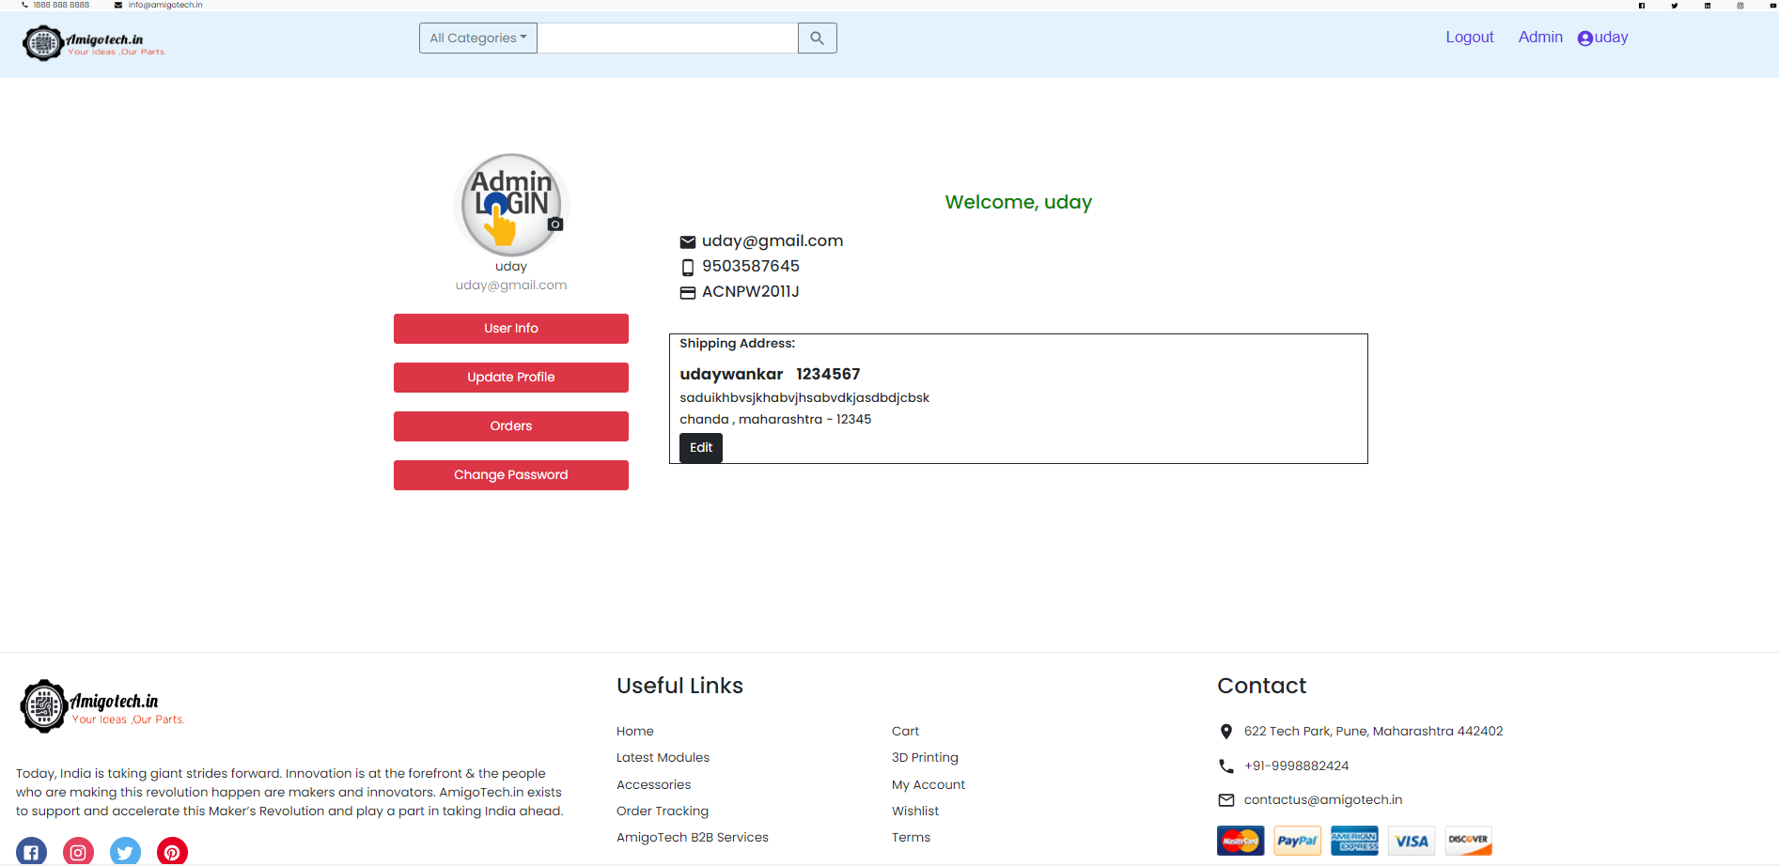
Admin Profile/user info

Slide 39
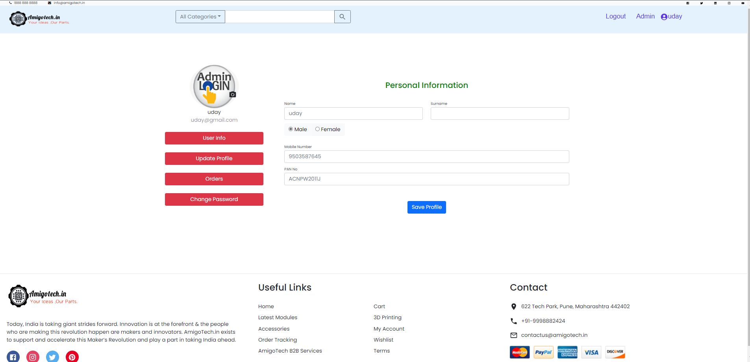
Update profile

Slide 40
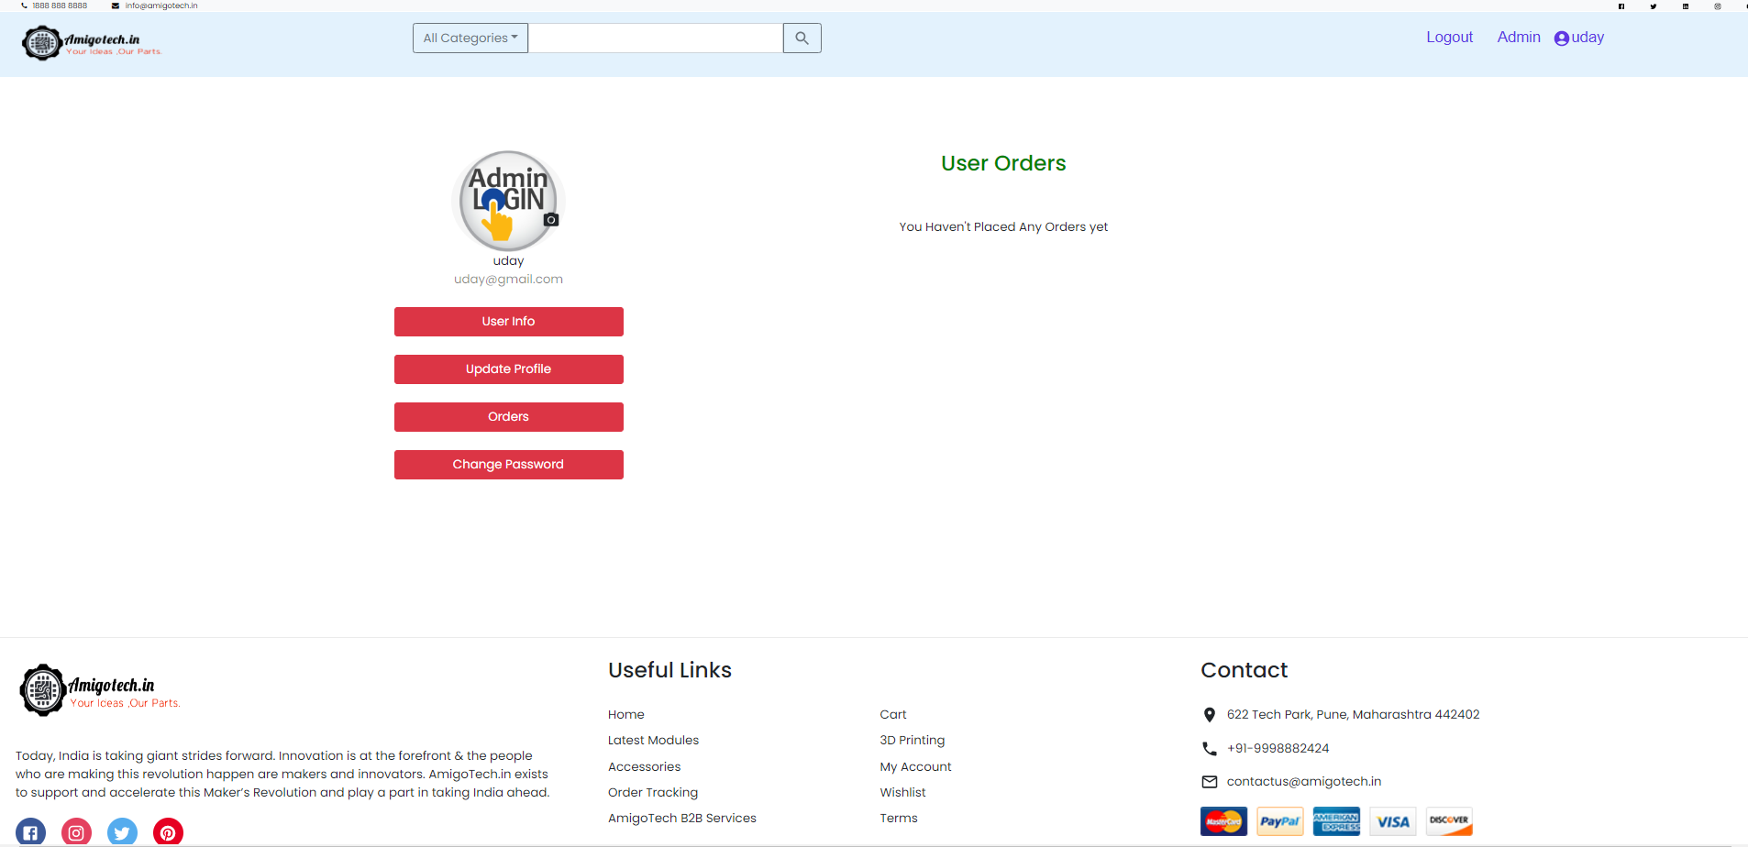
Admin orders

Slide 41
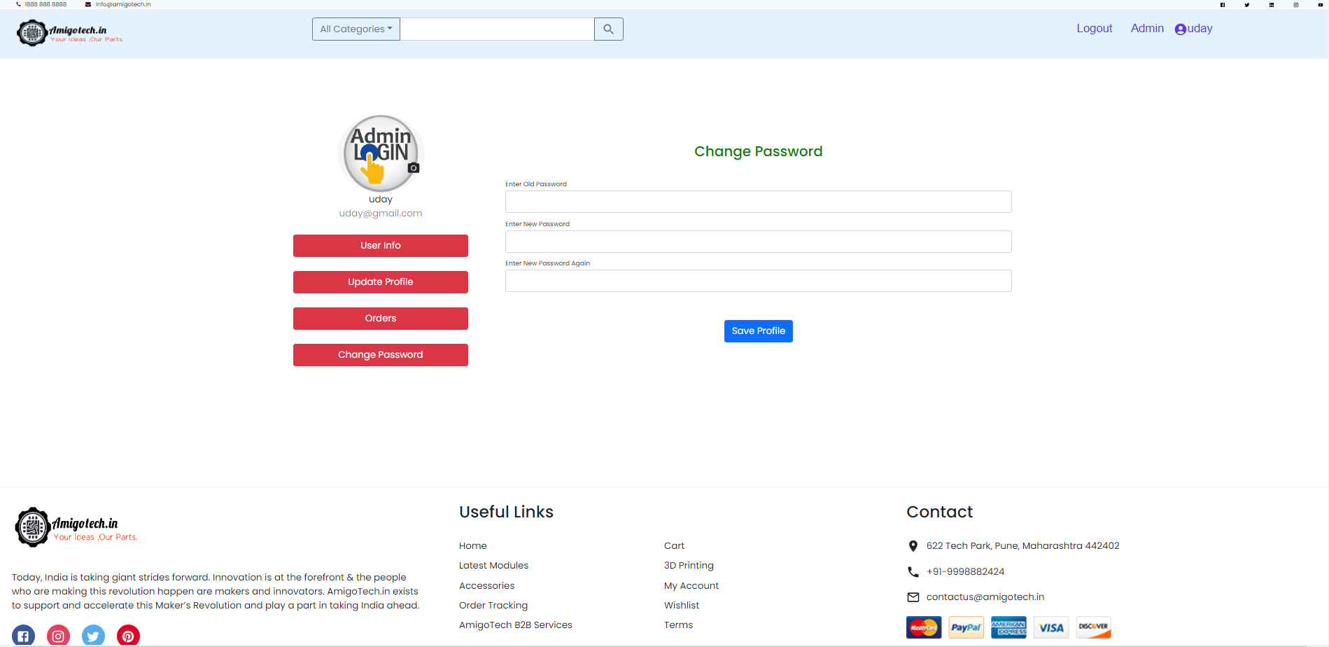
Admin orders

Slide 42
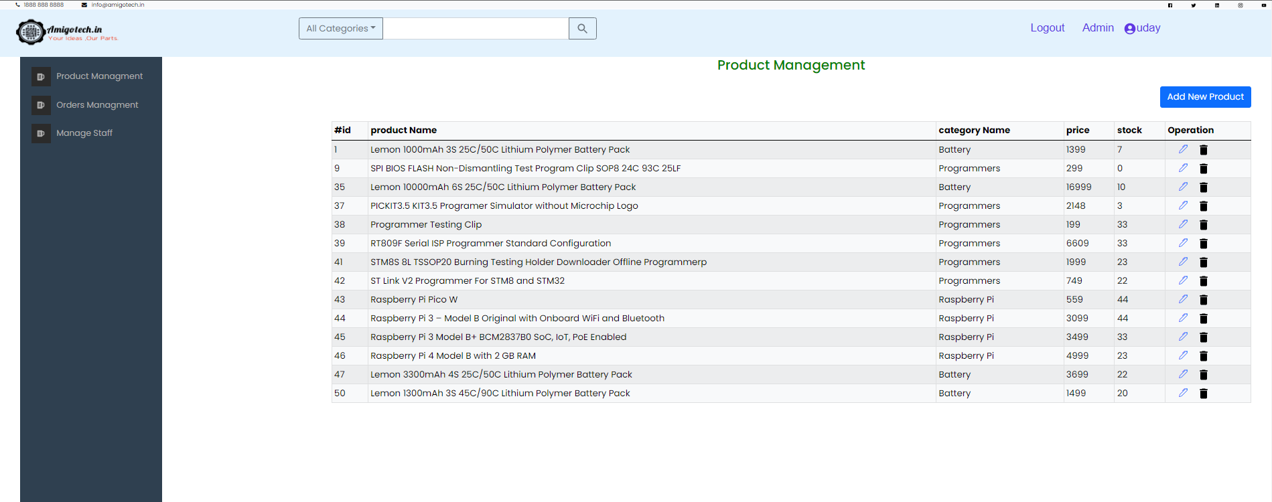
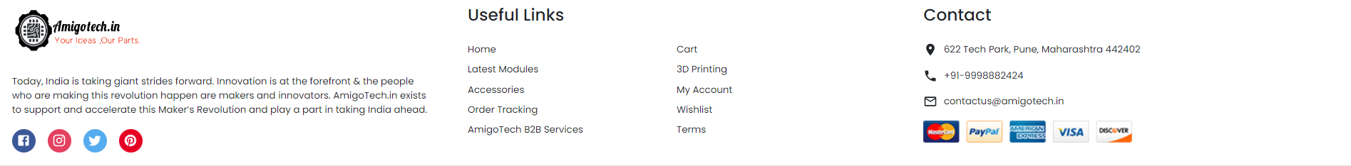
Admin Services/Product management

Slide 43
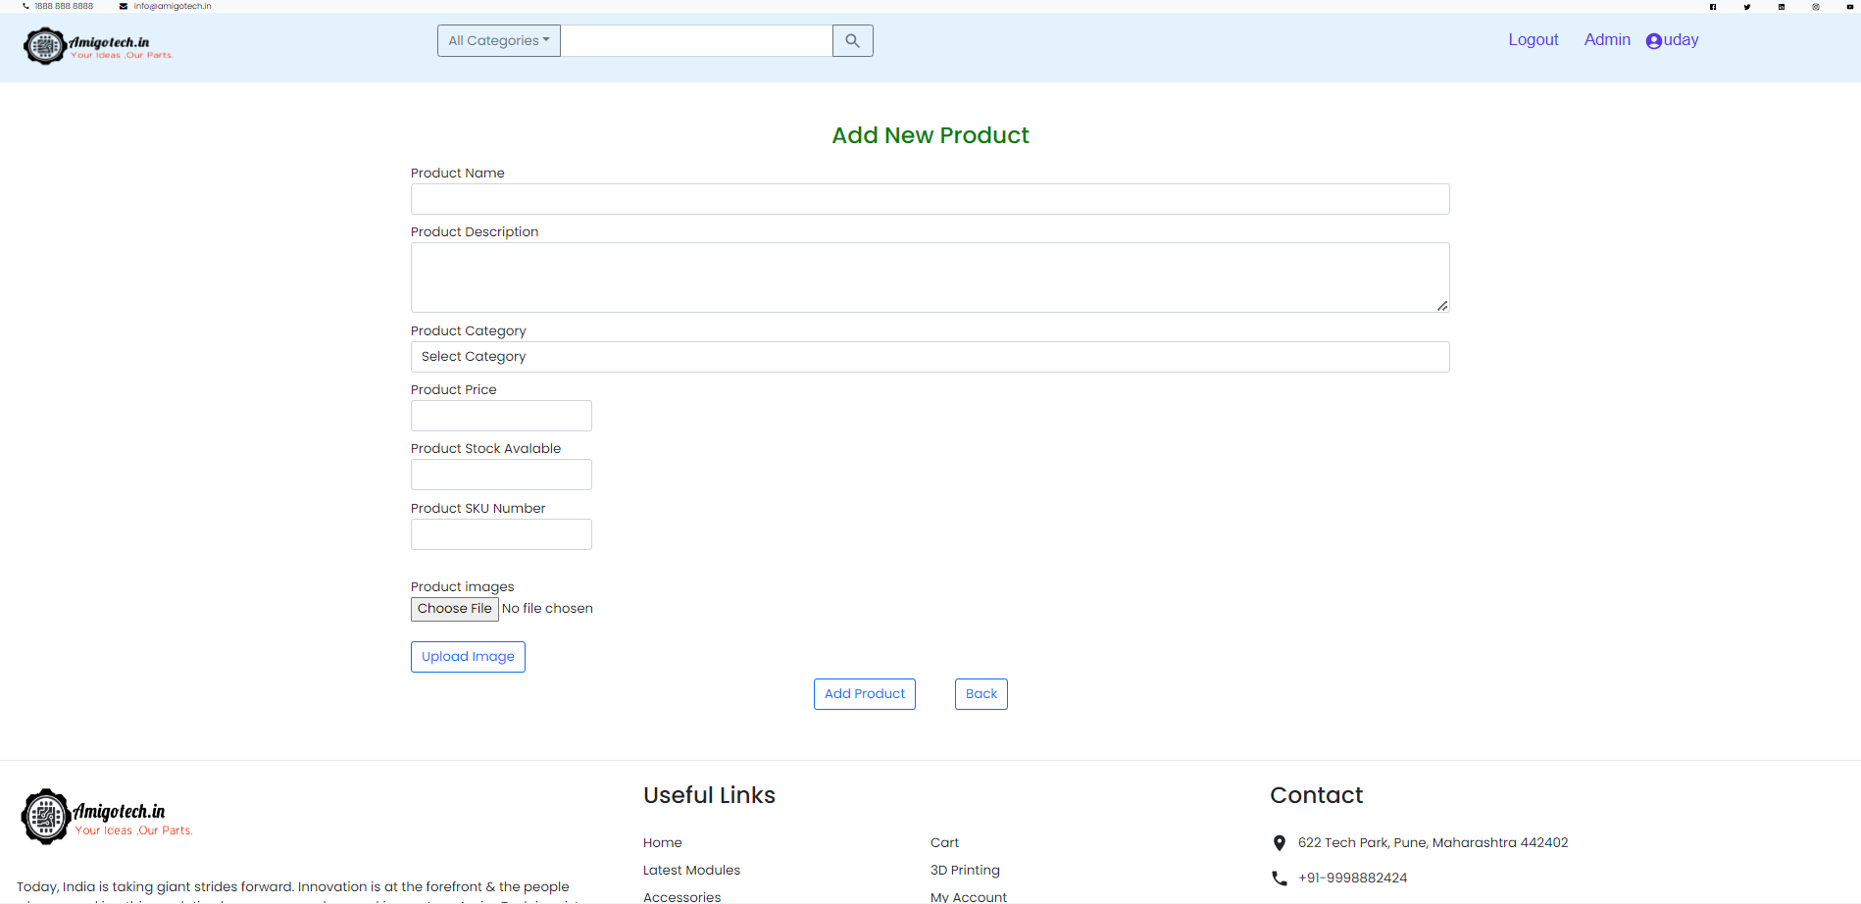
Add Product

Slide 44
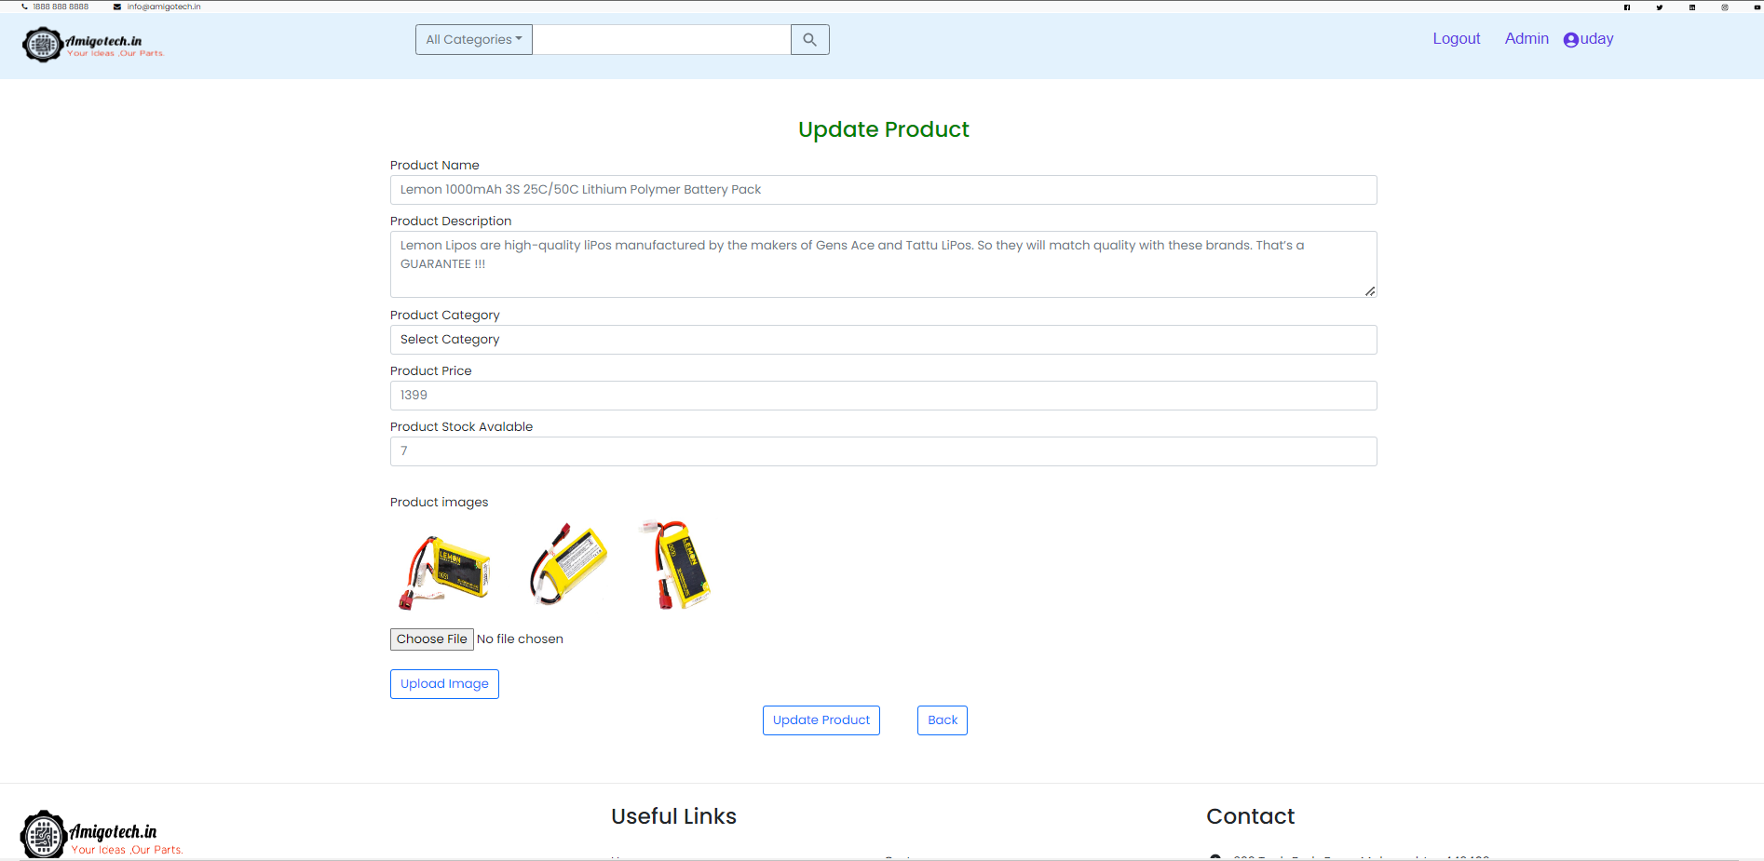
Update Product

Slide 45
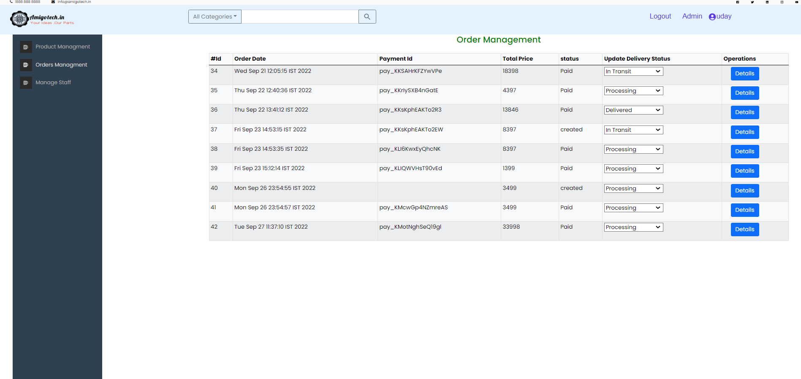
Order management

Slide 46
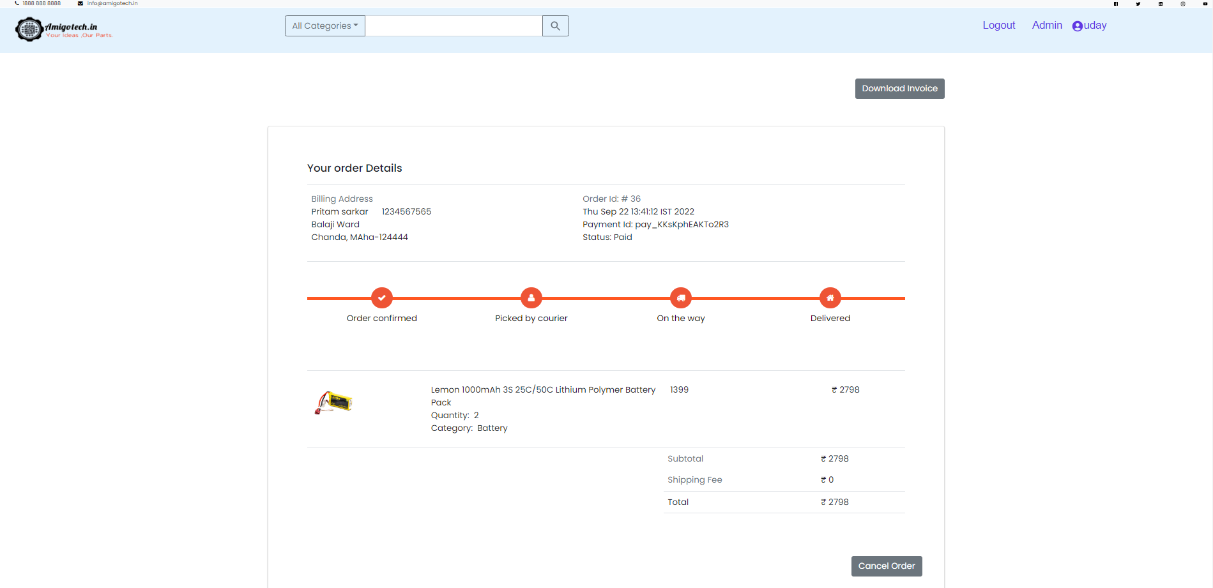
Order Details

Slide 47

Staff Management

Slide 48

Add Staff
Forgot Pass/Reset Password

Slide 49

Logout

